Slide 1
YPA’s Are Here to Stay
Presented by:
Tiara Springer-Love
Director of Youth Power
&
Robbie Lettieri
Youth Peer Services Training and Credentialing Manager
Families Together in New York State
Notes:
Both offer intros

Slide 2
FTNYS Families Together in New York State
Family-run organization that represents families of young people with social, emotional, behavioral, and cross-systems challenges.
Credentialing body of the Family Peer Advocate (FPA) credential, and Youth Peer Advocate (YPA) credential.
Youth Power is Families Together's statewide network that is run for and by youth and young adults.
Notes:
Tiara

Slide 3
FTNYS Goal
Our goal is to ensure that ALL children and youth have the support they need in order to succeed.
Youth Power
Youth Power is the New York State network of young people who have been labeled and are seeking change. Together, we have decided to speak up about our experiences because no one knows what it is like for us better than we do.
Notes:
Robbie

Slide 4
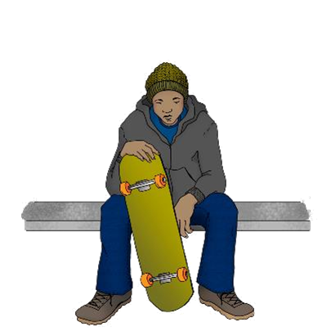
Principles of Youth Peer Support
Youth Guided
Partner with Young People
Promote Independent Recovery
Provides Mentoring
Promotes Advocacy
Culturally Curious/Humble
Notes:
Robbie
Is Youth Guided - Acknowledges that every
young person has a choice and should be
informed, consulted and active participants in
their own lives, as well as policies and
procedures governing care for all young
people in their community, state, and nation.
Partners with Young People - Recognizes
that power should be shared in making
decisions with young people based on their
understanding and maturity.
Promotes Independent Recovery - Provide
young people with the tools to make
educated and informed decisions on their
own health and wellbeing.
Provides Mentoring - Shares personal journey
of recovery to foster hope for youth and their
families.
Promotes Advocacy - Listens to young people
without judgment and promotes
environments where young people are heard
and their voice is sustained.
Is Culturally Competent - Creates safe
environments that respect and empower
young people to feel a sense of pride in their
cultures and beliefs that they identify with.
Makes Connections - Facilitates connections
between young people; their services,
agencies, activities, training, and peers for
support and advocacy.
Is Individualized - Acknowledge that a young
person’s recovery journey and experiences
are unique to them.
Is Strength-Based- Moves the focus away
from deficits towards building on the
strengths and resources that the young
person can use to better their own lives.
Makes Connections
Is Individualized
Strength-Based

Slide 5
What’s Your Comfort Level?
What is your comfort level with engaging young adults?
Not Comfortable at all
Somewhat comfortable
Very comfortable
Notes:
Tiara

Slide 6
What is Youth Engagement?
Youth engagement is the result when young people are involved in responsible, challenging actions to create positive social change. This means involving youth in planning and in making decisions that affect themselves and others.
Youth engagement happens in youth-adult partnership that are structured so that both groups contribute, teach, and learn from each other.
Other phrases for “youth engagement”
Youth Guided
Youth Voice
Youth Participation
Youth in Governance
http://actforyouth.net/youth_development/engagement/
Notes:
Tiara
This may not be what you all have thought about YE
Some may have thought YE is just having young people showing up but YE is MUCH MORE

Slide 7
Why Do We Need Youth Engagement?
Young people benefit by gaining skills, knowledge, self-esteem, and connectedness.
Adults benefit by enhancing their own competencies, learning to better understand and value youth, and increasing their commitment and energy to their organizations.
Organizations benefit by improving their programs, gaining community recognition, and attracting funders.
Communities benefit by improving quality of life, coordinating youth services, and authentically embracing diversity by representing young people.
Increased number of youth members/participants
http://actforyouth.net/youth_development/engagement/
Notes:
Robbie
-How are we marketing our programming?
-How are we utilizing youth engagement?

Slide 8
What Does Youth Peer Support Include?
There are five categories of Youth Peer Support that are Medicaid billable through CFTSS.
A Youth Peer Advocate (YPA) is able to offer all five categories listed below based on individual needs and preferences of the young person.
Skill Building
Coaching
Engagement, Bridging & Transition Support
Self-Advocacy, Self-Efficacy, & Self-Empowerment
Community Connections & Natural Supports
Notes:
Tiara
-Speak to the work of a YPA within the scope of CFTSS

Slide 9
YPA Credential Requirements
Provisional Credential
Professional Credential
Lived Experience
Level 1 Training
18 or over
High School Diploma or equivalent (Education Waiver for eligible candidates)
2 letters of Recommendation
Statement of Lived Experience
Signed Code of Ethics
Level 2 Online Training & IN PERSON/Virtual Training
Supervisor Letter of Recommendation
Documented Work Experience
600 hours for YPAs
Signed Code of Ethics
Renewed every 2 years with 20 hours of Continuing Education
Notes:
Robbie
No fee for application or renewal, if someone is late there is a $10 fee
Important to keep an eye on when your credential expires

Slide 10
Level-1 YPA Training
Orientation Resources
6 Steps to a Youth Peer Advocate Credential
Youth Power Demographic Questionnaire
Level 1 Required On-Line Training Modules
1.1 Introduction to the Youth Peer Advocate Role
1.2 Developing Self Efficacy
1.3 Cultural Competence
1.4 Professional Expectations
1.5 Small Group Facilitation
1.6 Navigating the System
1.7 Documenting Your Work
Notes:
Robbie
After completing Level 1 Training, you would then apply for the YPA Provisional Credential: (insert link)

Slide 11
Level-2 YPA Training
A. Required On-Line Training Modules
2.1 Working Across Systems
2.2 Service Systems Part 1
2.3 Service Systems Part 2
2.4 Education to Careers
2.5 Understanding Marginalized Populations
B. In-Person Training (2 Days)
Engagement, Communication, Partnership and Empowerment Strategies
Putting it All Together: YPA Role, Ethical Conduct, Progress Evaluation, Plan Revision, Documentation
C. Coaching Calls
Five 1.5 hour calls to reinforce application of skills and competency in practice
Notes:
Robbie
Consultation Calls:
Personal & Professional Self Care
Role Clarity
Working with a Team
Building on Strengths Through Cultural Humility
Utilizing Your Skills to Empower Young People

Slide 12
Tools for Effective Youth Engagement
Youth participatory evaluations
Person centered planning
Trauma informed approaches
Self directed practices
Creating spaces specifically for T-A-Y
Notes:
Tiara
-Spaces can be rec-rooms, rec-centers, places specific for each youth depending on where they are at (classes, outdoor settings, lounge areas, etc.)
-Do you offer hands on learning opportunities?
-Do the young adults have a leader within this organization that speaks their language/looks like them?
-Do you staff reflect the community that you serve?
-Do you have an informal/formal peer support model that you follow?
-Are there opportunities for participation and community service (Stand Up for Recovery, writing letters to veterans, volunteer for food pantry)
-Where are opportunities for young adults to give back and still allow them to feel like they are contributing to society
-Do young adults have choice? (Is there a schedule or menu of services? … Clubhouse)
Robbie
SPEAKER

Slide 13
YOUTH ENGAGEMENT IS NOT
Manipulation:
Adults use young people to support their own projects and pretend they are the result of young peoples inspiration
Decoration:
Young people help implement adult initiatives
Tokenism:
Participation for show – young people have little or no impact on their activities
Notes:
Tiara

Slide 14
LET’S HEAR FROM THE YOUNG ADULTS
https://www.youtube.com/watch?v=iOA3il4cetI
Notes:
-What are some strategies that have been least effective for you?
https://www.youtube.com/watch?v=iOA3il4cetI

Slide 15
YOUTH & ADULT PARTNERSHIPS
Notes:
Tiara
Manipulation
Decoration
Tokenism
Assigned but informed
Consulted and informed
Adult-initiated, shared decisions with youth
Youth-initiated and directed
Youth initiated, shared decisions with adults
Youth engagement loses authenticity when adults are conflicted about questions of power and control. In his Ladder of Young People's Participation, Roger Hart described in detail levels of non-authentic and authentic youth engagement. The first levels of manipulation, decoration, and tokenism denote failed or false attempts at youth engagement, when young people appear to be in decision-making positions but in reality have no or very little input on events.
A powerful underlying reason for non-authentic youth engagement is adultism -- the behavior and attitudes that flow out of negative stereotypes adults hold about young people. Adultism is rooted in the belief that young people lack intelligence or ability. This belief is strongly supported by societal norms which leave young people feeling that they are not valued, respected, or heard. Even adults who deeply care for young people may have internalized these misconceptions and may not be aware that they are behaving in an adultist manner.

Slide 16
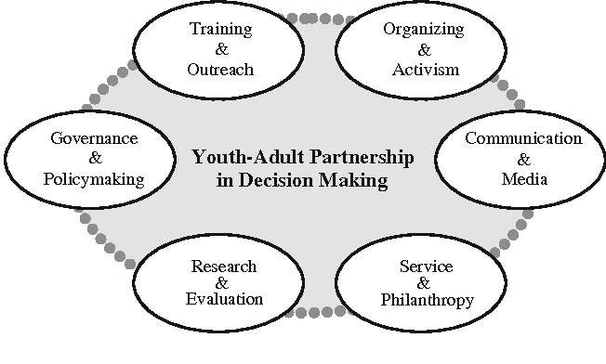
YOUTH & ADULT PARTNERSHIPS
https://www.semanticscholar.org/paper/Youth-Adult-Partnerships-in-Decision-Making%3A-and-an-Zeldin-Petrokubi/1523ac6dc144d65f964e10964868d38b435dc81c
Notes:
Tiara
-Do you have young people who serve on your board of directors
-Do you have a youth advisory council
Governance and Policymaking
-If an organization serves young people, then it makes sense to have youth in key roles of organizational decision-making. Youth may serve on the board of directors or key committees, allowing their input to be heard on important organizational matters.
Training and Outreach
-If an organization serves young people, then it makes sense to have youth in key roles of organizational decision-making. Youth may serve on the board of directors or key committees, allowing their input to be heard on important organizational matters. Youth can contribute significantly to training of adult staff and community members. At a minimum, adults benefit from hearing the youth perspective. But, adults also learn from observing youth at work. Youth often raise questions and issues that others may not have considered.
Organizing and Activism
Youth can work with staff to organize community members around issues. Youth often know how best to recruit youth to get involved with the organization. Adults can learn recruitment strategies from youth.
Communication and Media
Youth can offer much in helping the organization get its story out to the public. Youth can contribute to press releases, they can meet with reporters, they can facilitate public forums, they can create staff newsletters. The list goes on. Youth can use new media technologies to create and widely disseminate videos and to communicate through text directly to their own networks.
Service and Philanthropy
While they may not have much money to give, young people have time, experience, and skills to offer to others. Youth of all ages can serve as mentors for younger youth within their organizations or within the larger community. Youth can supervise program activities, and they can do one-on-one work. Almost all youth wish to give back to the “next generation.”
Research and Evaluation
Organizations are increasingly required by funders to demonstrate their accountability and accomplishments. Organizations are also using self-assessment strategies to explore program quality and to create program improvement plans. Youth can contribute to these efforts in many ways. Not only can they serve as “subjects,” giving their judgments on key organizational issues, but equally important, youth can serve as researchers. They can interview other youth and community members, work with staff to analyze the data, and help present it to organizational

Slide 17
THE IMPACT OF COVID-19
Two-thirds of young people reported that they were struggling or starting to struggle to pay their bills.
Two-thirds reported a reduction in, or loss, of employment and providers reported that helping youth navigate filing for unemployment benefits was a highly requested service.]
Just over half reported they are experiencing some level of food insecurity.
https://azchildren.org/news-and-events/the-impact-of-covid-19-on-youth-aging-out-of-foster-care/
Notes:
Robbie
-Mindfulness
-Person centered
These are the topics that young adults are facing due to COVID + these are some of the challenges that COVID is exposing
-How has COVID impacted your programming?
Robbie

Slide 18
THE IMPACT OF COVID-19
Over 1/3 of young people reported that the health crisis had a negative impact on their educational progress.
More than half reported struggling with safe and stable housing and their service providers and allies listed housing at the top of the list of requests for assistance and at the top of list where resources were lacking.
COVID has exposed disparities within communities of color
https://azchildren.org/news-and-events/the-impact-of-covid-19-on-youth-aging-out-of-foster-care/
Notes:
Robbie

Slide 19
COVID’s IMPACT IN COMMUNITIES OF COLOR
People of color are:
• at an increased risk for serious illness if they contract COVID-19 due to higher rates of underlying health conditions, such as diabetes, asthma, hypertension, and obesity compared to Whites;
• more likely to be uninsured and to lack a usual source of care which is an impediment to accessing COVID-19 testing and treatment services;
• more likely to work in the service industries such as restaurants, retail, and hospitality that are particularly at risk for loss of income during the pandemic;
• more likely to live in housing situations, such as multigenerational families or low-income and public housing that make it difficult to social distance or self-isolate; and
• often working in jobs that are not amenable to teleworking and use public transportation that puts them at risk for exposure to COVID-19. (Kaiser Family Foundation, 2020; Health Affairs, 2020)
https://www.samhsa.gov/sites/default/files/covid19-behavioral-health-disparities-black-latino-communities.pdf
Notes:
Tiara

Slide 20
CHALLENGES FACED BY YOUTH AT LARGE
Discrimination
Discrimination is still one of the primary reasons TAY do not seek help for mental health challenges.
Lack of representation
Transition Age Youth are underrepresented, they do not have a voice in local or state governments and all too often the needs of TAY are ignored.
Absence of Trust
Youth do not trust local and state elected officials, police officers, counselors, and mental health providers.
Lack of TAY Specific Services
Transition Age Youth do not have their own mental health system of care. They fall in the children’s or adult systems of care and these structures are inadequate in addressing the needs of TAY.
https://ca-yen.org/tay-101/challenges-faced-by-tay/
Notes:
Robbie

Slide 21
CHALLENGES FOR YOUTH
Disempowerment
Youth feeling less than an equal partner in meetings, committees, and boards. TAY are led to believe that their voice does not matter – but it does!
Misunderstanding of TAY Culture
People do not understand the culture of today’s youth which furthers stigma and discrimination.
Access to services already in existence
Even when a youth is able to overcome stigma, many youth still do not know where to go, or who to turn to when they need help.
Housing
California has one of the highest rates in the country of homeless youth. In order for youth to find success, they need a stable place to live!
Education
Youth need opportunities to become successful and a path to an education can open the door to success.
https://ca-yen.org/tay-101/challenges-faced-by-tay/
Notes:
Tiara

Slide 22
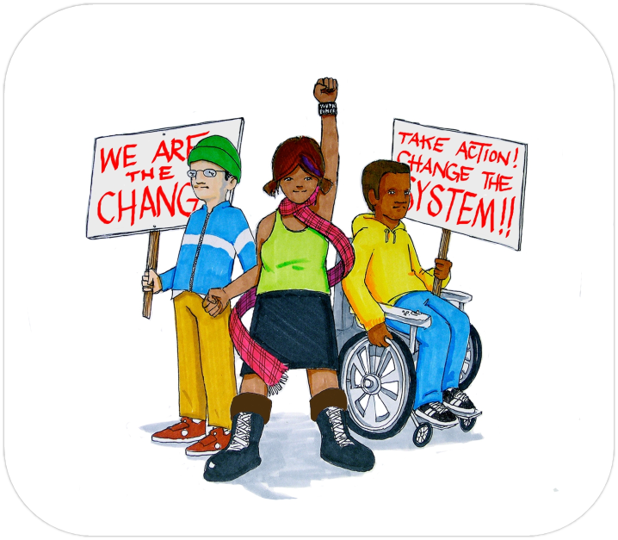
STATEWIDE NETWORK ACTIVITIES
Regional focus groups for young people
Regional Peer Leader Support & Development (PLSD) and Youth Peer Advocate Leaders (YPAL) Meetings
Training, Educational & Skill Building Workshops
Technical Assistance (TA)
YP membership, YP Ambassadors
Youth Power Advisory Council
Free 2 Be Podcast
#YPSpreadHope Campaign
Notes:
Robbie

Slide 23
RESOURCES & TOOLS
Tools for Youth Engagement:
https://adamfletcher.net/wp-content/uploads/2014/09/ASIYE.pdf
COVID-19 and Behavioral Health Disparities for Black and Latino Communities in the U.S.
https://www.samhsa.gov/sites/default/files/covid19-behavioral-health-disparities-black-latino-communities.pdf
Creating Youth & Adult Partnerships:
https://www.semanticscholar.org/paper/Youth-Adult-Partnerships-in-Decision-Making%3A-and-an-Zeldin-Petrokubi/1523ac6dc144d65f964e10964868d38b435dc81c

Slide 24
QUESTIONS & DISCUSSIONS

Slide 25
Contact:
Robbie Lettieri,
Youth Peer Services
Training and Credentialing Manger
Email:
Rlettieri@ftnys.org
Phone:
585-866-9333
Connect with Us
www.ftnys.org
@YOUTHPOWERNY
@Youth Power
Contact:
Tiara Springer-Love, MSW
Director of Youth Power
Email:
TSpringerLove@ftnys.org
Phone:
518-478-3769
Connect with Us
www.ftnys.org
@YOUTHPOWERNY
@Youth Power

