Slide 1
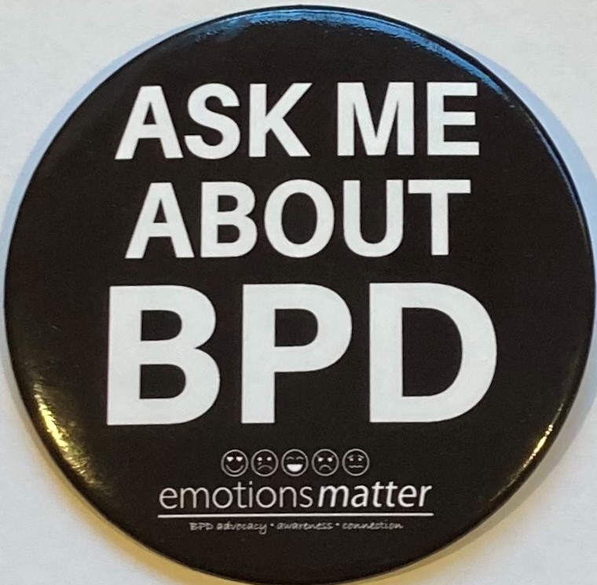
Alternatives Conference 2021
Peer Support for Borderline Personality Disorder Recovery
Hannah Fox, Emotions Matter Peer Group Trainer
Rachel Hay, Emotions Matter Peer Facilitator
www.emotionsmatterbpd.org
P.O. Box 7642
Garden City, New York 11530
paula@emotionsmatterbpd.org
Notes:
PAULA
Emotions Matter Inc. is a 501c3 non-profit organization founded in 2015 by a network of individuals, family members, and clinicians affected by BPD.
Its mission is to improve community support, education and advocacy for BPD. Emotions Matter’s vision is to create a world in which every individual impacted by BPD has access to a proper diagnosis, educational resources, and treatment to achieve a meaningful recovery.
Jill

Slide 2
Emotions Matter’s Philosophy
Mission Statement: To support, education and advocate for people impacted by borderline personality disorder (BPD).
Emotions Matter strives to create a safe, judgement-free space for people with borderline personality disorder.
We accept that there is a spectrum of experiences within the BPD community.
We honor where people are on the journey, without judgement or assumptions.
We encourage people to define their own path toward recovery.
We speak as experts of our own lived experience, not as medical experts.

Slide 3
Guidelines for Community Engagement
1. We accept difference and promote acceptance, especially with regard to gender, identity, race, ethnicity, age, sexual orientation, religion, disability or politics.
2. This discussion may bring up intense and painful emotions, feelings, memories, thoughts and/or reactions. If at any time during the panel, you find yourself overwhelmed, struggling or for any reason in need of support, we encourage you to reach out to your support system, seek a mental health professional, engage in self-care, or take a break entirely.
3. This session will be recorded and made available to Alternatives after the conference. If you want to turn off your camera at any time, feel free to do so.
4. Questions during sessions should be asked using the chat.
5. Use respectful language in the session chat. Any inappropriate messaging, including harassment, bullying, or monopolizing the chat will be deleted.

Slide 4
Panel Outline/Presentation
Welcome, Disclaimers and Guidelines
Lived Experience Presentation – Hannah - On finding Emotions Matter
Emotions Matter’s BPD Peer Online Support Group Program
Lived Experience Presentation – Rachel – On being a peer facilitator
Closing and Q&A

Slide 5
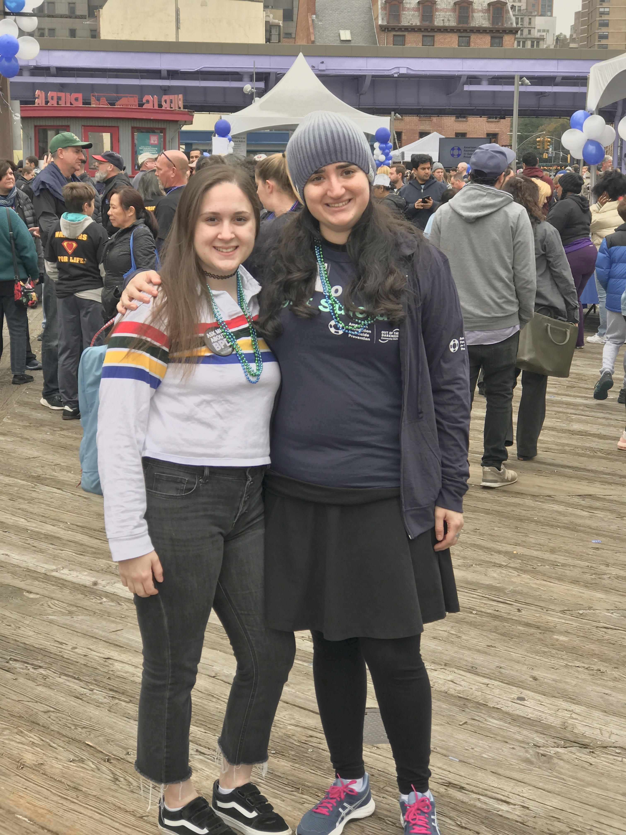
2016 Focus Group: Hannah’s Story

Slide 6
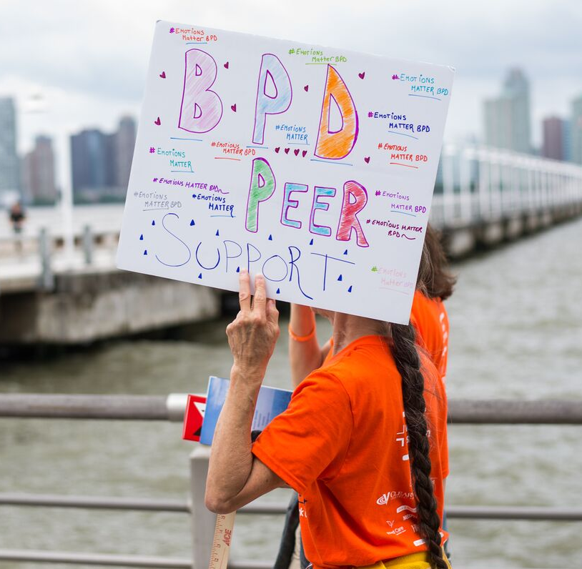
Addressing a Gap: The Lack of Community Peer Support for BPD
Loneliness and social anxiety are commonly reported by individuals with BPD.
Those with BPD are at a high risk for self-harm or suicidality.
The internalization of stigma and barriers to care often prevent individuals with BPD in seeking help.
A lack of visible, positive BPD recovery models exist, along with social connectedness with those working toward recovery.
The efficacy of peer support for mental health is well documented, but it is an emerging field within BPD.
COVID has increased both the social isolation for those with BPD, as well as the demand for online community-based support.
Notes:
PAULA

Slide 7
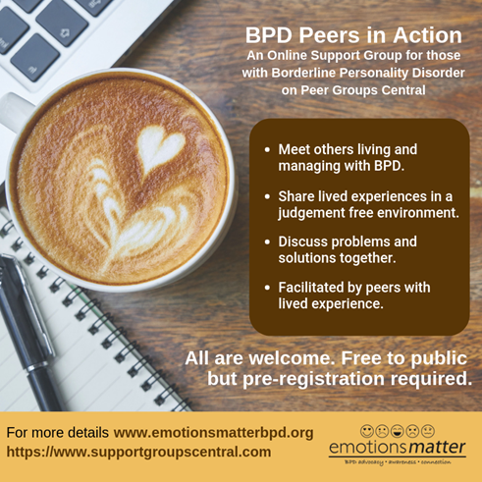
2017
Worked with a committee of peers with lived experience to develop peer program
2018
Peer facilitators who identify as being in recovery for BPD were recruited and trained.
2019
Program piloted and fully launched on www.supportgroupscentral.com.
The curriculum utilizes peer experience to promote recovery, safety, social support, empowerment, problem-solving.
Notes:
Paula
The intervention curriculum was developed by a diverse group of stakeholders, including clinicians and those with diagnosed BPD.
Peer Facilitators who identify with BPD recovery recruited and trained in Fall of 2018. Training is 8 hours with 6 months of supervision.
A 4-session online feasibility intervention was offered to subscribers from March to May. In June, the program transitioned to 1-hour bi-weekly drop in sessions. piloted its BPD peer support program in person and online in 2019 on platform SupportGroupsCentral.com March-May 2019. In June 2019, moved to online only intervention.

Slide 8
Structure is key to success
Four Recovery Principles: Rotating Curriculum Topics
Advocacy
Community
Purpose
Trust
Identifying Obstacles on the Road to BPD Recovery: Hope and Cope Together
Managing Relationships and Borderline Personality Disorder
Identifying Purposeful Life Activities: Embracing Strengths and Moving Beyond BPD Labels
Believing in Oneself and One’s Ability to Recover from BPD
Synopsis – why we have recovery principles
Notes:
Paula

Slide 9
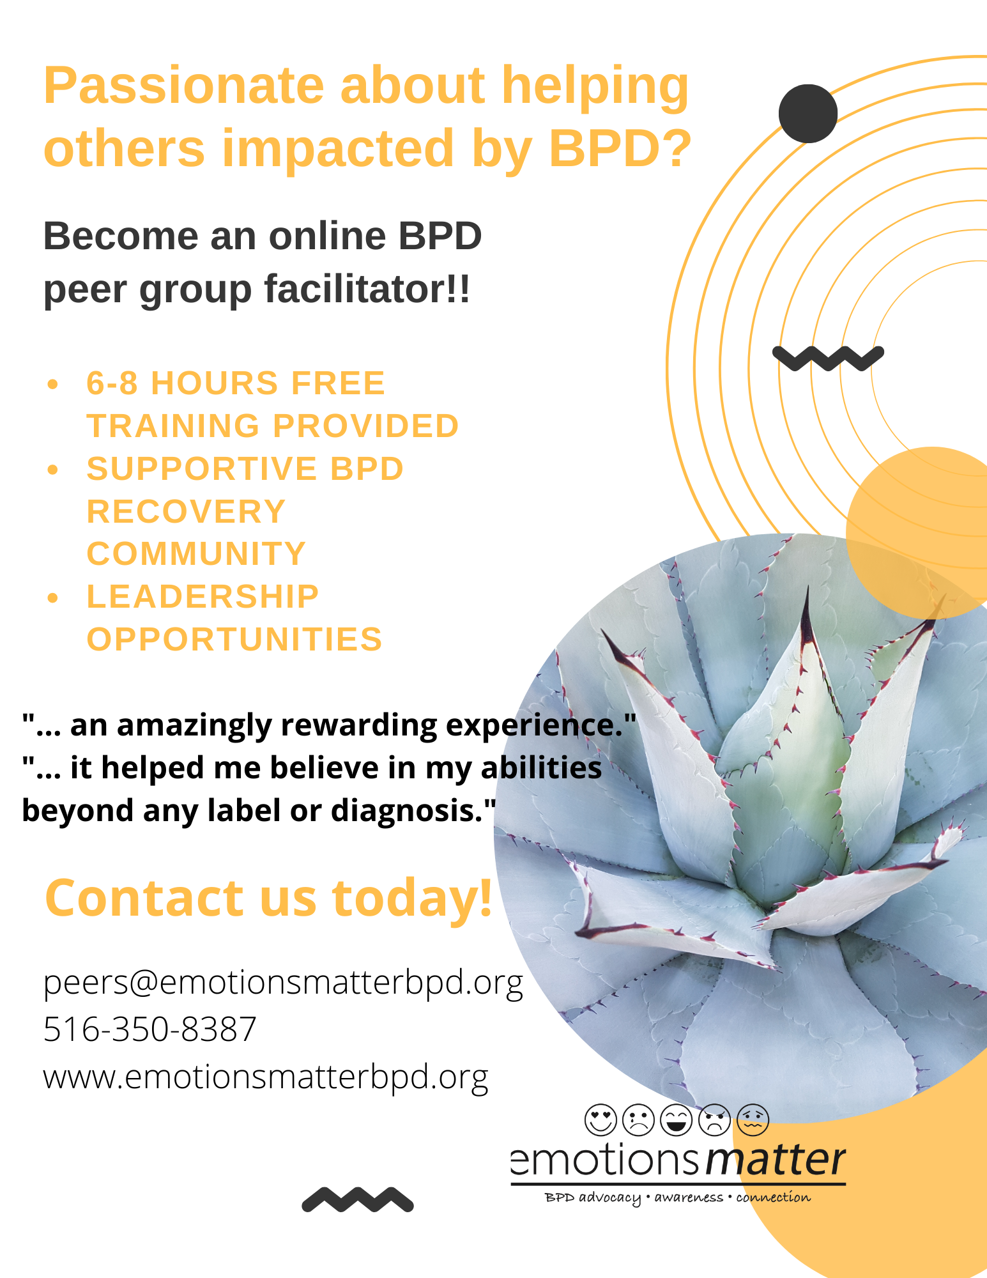
Role of Peer Narrative: How Principles Support BPD Recovery
Advocacy
Community
Purpose
Trust

Slide 10
Growth of subscribers, attendees, and waitlists demonstrate significant interest and need
Since early 2019:
1,260 subscribers to BPD Peer Online Support Groups
Waiting List 900+ during COVID
Attendees: 320 attended in 2020
Currently, we have 13 facilitators and offer up to 6 groups a month.
Notes:
JILL
I’ve been working with Paula at EM on the evaluation of this program. I developed the subscriber survey.

Slide 11
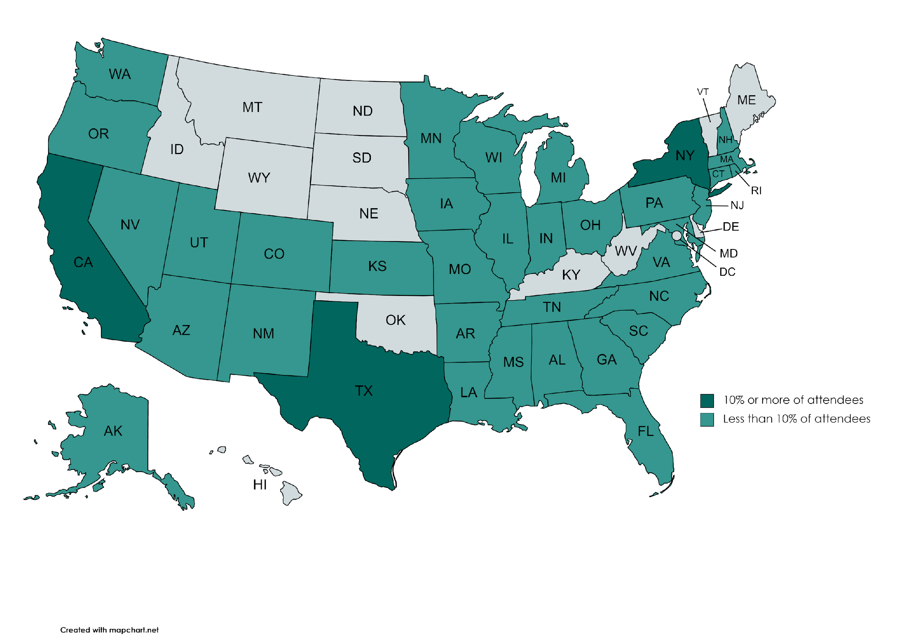
273 attendees from around the country and the world
Canada, United Kingdom, Indonesia, Ireland, Barbados, Croatia, Italy, Switzerland, Turkey, United Arab Emirates, Uruguay
Notes:
JILL
Grey means no one has attended from those states.

Slide 12
The groups are a safe space to connect and learn from each other—a demonstration of positive models of recovery.
I learned new skills.
I am not alone in this fight.
I feel supported.
Recovery is possible.
I am inspired.
Hopeful that things can get better.
I am proud of myself.
Uplifting and informative.
I feel heard and understood.
Reminds me to practice skills.
Notes:
JILL

Slide 13
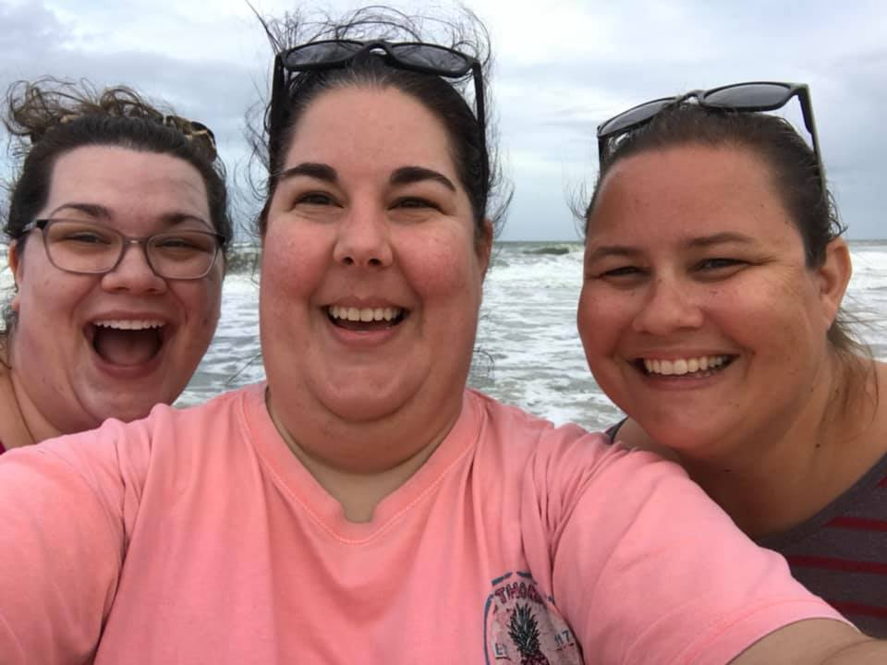
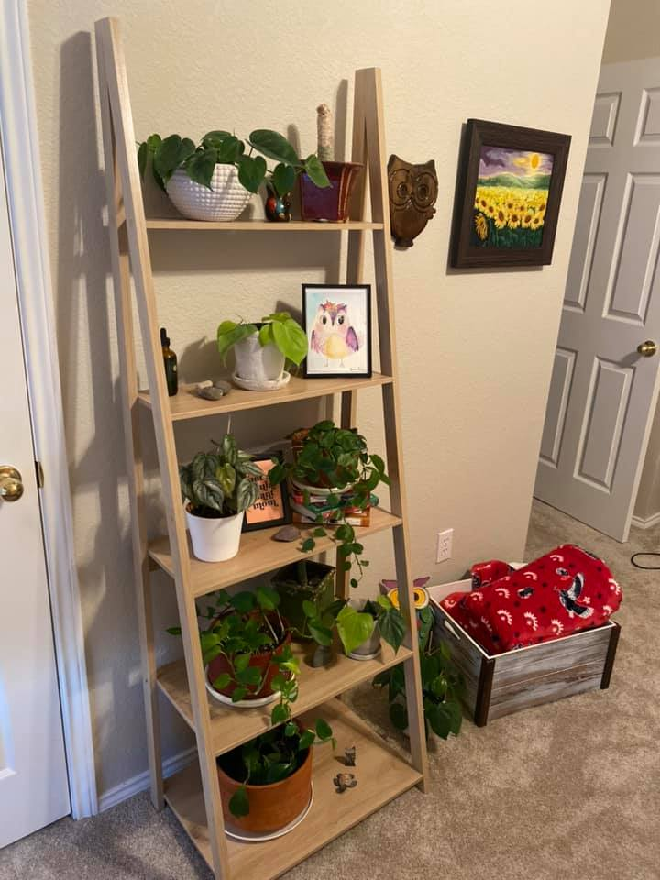
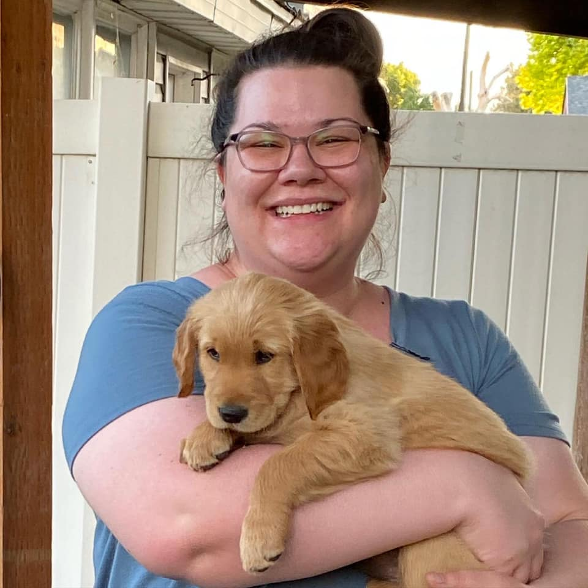
Rachel’s Story

Slide 14
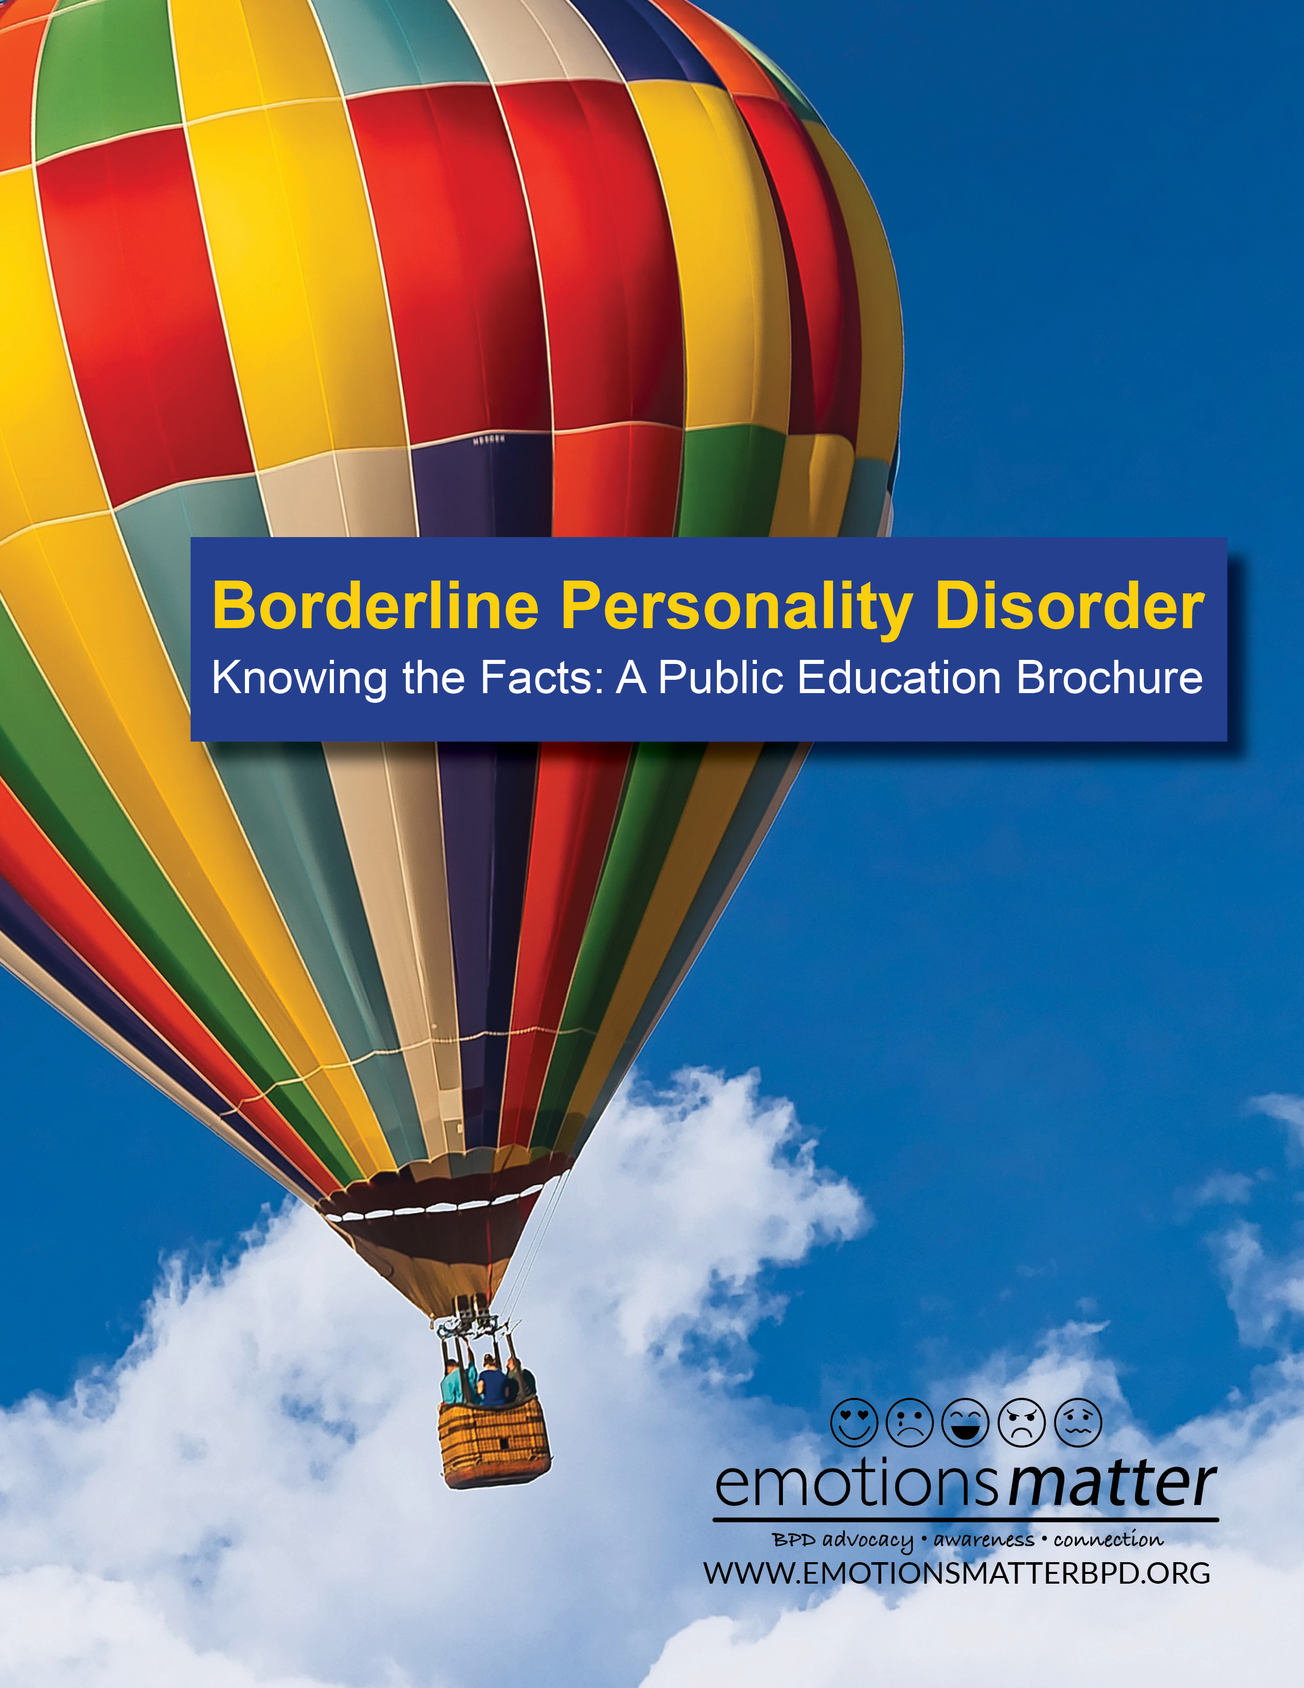
Resources & Questions
Emotions Matter Peer Resources
www.emotionsmatterbpd.org
www.supportgroupscentral.com
Treatment Resources:
https://www.nyp.org/bpdresourcecenter
Family Resources/Education
https://www.borderlinepersonalitydisorder.org/

Slide 15
Acknowledgements
Authors: Teresa Burgado, Chelsea Spearman, and Paula Tusiani-Eng, LMSW
Evaluators: Sarah Fineberg, MD; Jillian Papa, MPH; and Yujung Choi, M. Sci.
Contributors: Maria Solomon, LCSW; Diana Diamond, PhD; Andrea Rosenhalf; LCSW-R; Hannah Fox; Kellyann Navarre; Liz Trainor; Penelope D.; Rachel Hay; Coral Lopez; Amanda Blachorsky; and Haley Amering.
Partners: Pro Bono Partnership, Morea Agency, and Support Groups Central.
Donors: McLean Hospital, New York Presbyterian Hospital, Francesco and Mary Giambelli Foundation, and individual donors.
www.emotionsmatterbpd.org
P.O. Box 7642
Garden City, New York 11530
paula@emotionsmatterbpd.org
Notes:
PAULA

Slide 16
Appendix A: Emotions Matter’s Community Guidelines
1. Your safety and well-being, as well as the safety of the group, is important to us.
2. Use respectful language. Words and body language matter. Be mindful of how others can interpret your communication.
3. We accept difference and promote acceptance, especially with regard to gender, identity, race, ethnicity, age, religion, or politics.
4. Respect confidentiality. No photographs, screenshots or video recordings of other group members.
5. Avoid making assumptions about other people’s experience of BPD. No judgement.
6. Show kindness and compassion for others who are struggling.
7. All are welcome to share, but participation is optional. No one person should monopolize group time.
8. Avoid interrupting, which can make other group member’s feel invalidated. Raise your hand when you want to visually alert the facilitator you want to speak.
9. Avoid explicit expressions of self-harm or trauma, which may be upsetting to others.
10. If at any point, you express concerns about your safety, we will offer support. If your emotions escalate and we are not able to comfort you, we will encourage you to reach out to your support system, or consult with mental health professional.

Slide 17
Appendix B: Borderline Personality Disorder (BPD) - Nine Diagnostic Criteria in DSM-V
Frantic efforts to avoid abandonment, real or imagined.
A pattern of unstable and intense relationships.
An unstable self-image or sense of self.
Dangerous impulsivity such as unsafe sexual encounters or substance abuse.
Recurrent suicidal behavior, gestures or threats, or self-mutilating behavior.
Emotional instability due to high reactivity.
Chronic feelings of emptiness.
Inappropriate intense anger or difficulty controlling anger.
Transient, stress-related paranoia or severe dissociative symptoms.
Notes:
Five out of 9 of these criteria have to be met to make the diagnosis. Read all 9 and mention how this is the only disorder where suicidal behavior is a part of the diagnostic criteria.

Slide 18
BPD in our Own Words
Emotional Dysregulation
Brain does not process emotions normally and this affects brains ability to regulate every day emotions, communication and experiences.
BPD affects behaviors, self-esteem and self-identity.
It can lead to emptiness, emotional pain, and shame.
BPD is a disability that cannot affect people’s ability to work, go to school or maintain relationships.
Education, Community Support, and Treatment can help on the journey toward hope and healing.

