Slide 1
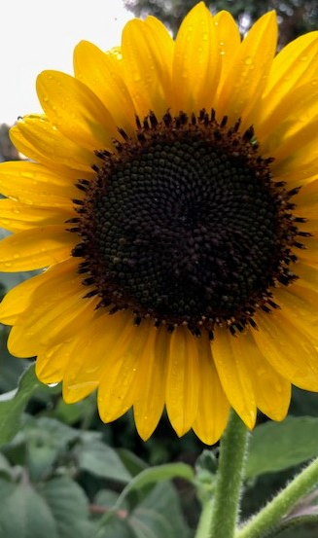
The Garden as Spiritual Practice
Joann Calabrese
joanncalabrese@gmail.com
www.Mindfulnessgardengames.com
Recovery Education Manager at Colorado Mental Wellness Network
joann@cmwn.org

Slide 2
Workshop Goals
- Define Garden Spirituality
- Identify how garden spirituality can support recovery, wellness, and community well-being
-Provide some practices to get you started

Slide 3
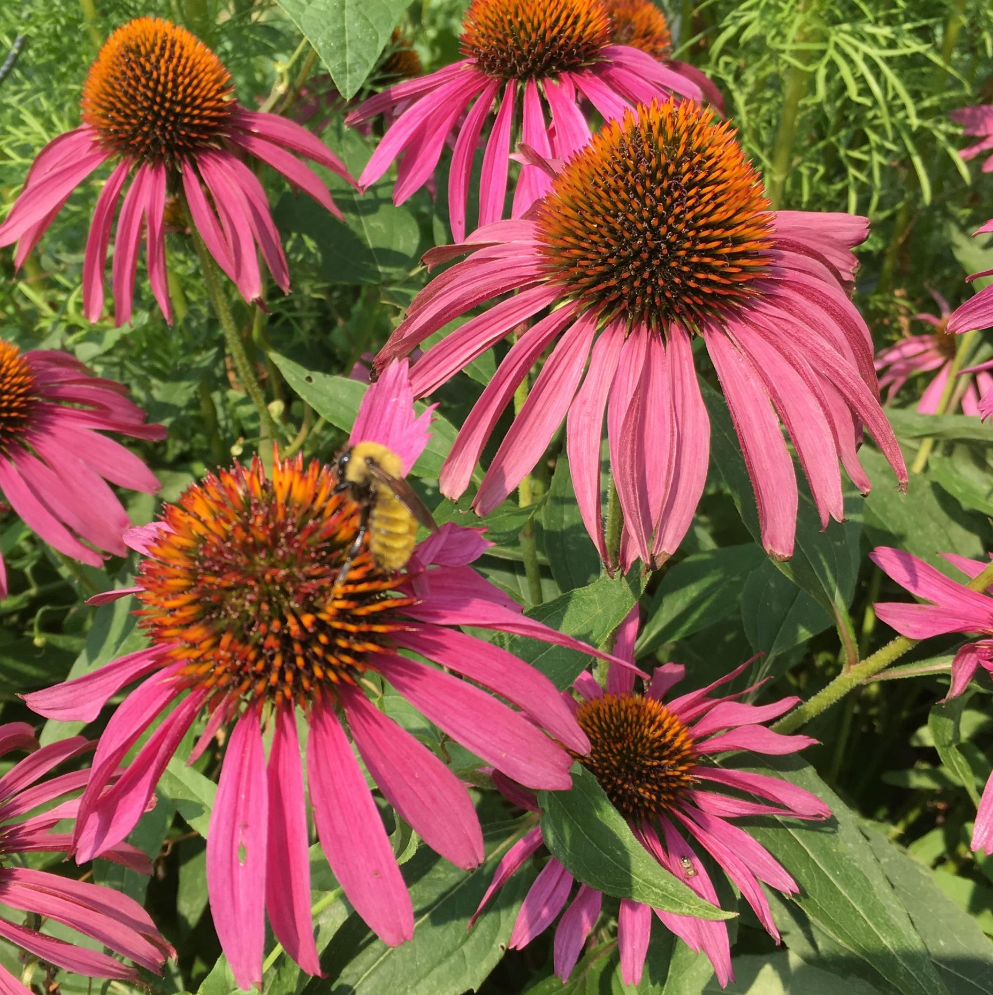
Defining Terms
Spirituality is a sensing and knowing that we are part of something bigger than ourselves - a larger interconnected reality.

Slide 4
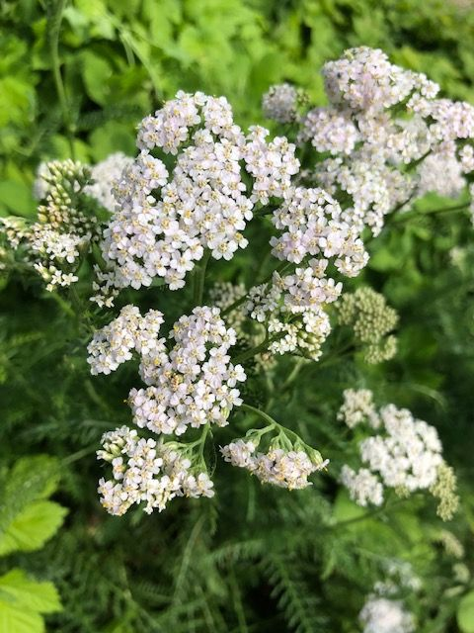
Spiritual Practice
-Any activity that nurtures our awareness of connection and deeper meaning.
-It is an intentional practice that keeps our spirituality in focus.

Slide 5
Mindfulness
a particular type of spiritual practice - being focused on what is arising both within and without

Slide 6
Benefits of Spiritual Practice
-Alignment with our spiritual awareness
-Nourishment of our spiritual selves
-Meaning and direction for our lives
-Comfort and clarity
-Guidelines for living and decision making
-Hope for ourselves, others, and the world

Slide 7
Why Garden Spirituality?
The green world is our life support system
It make life on the planet possible.
We are interconnected with the green world.

Slide 8
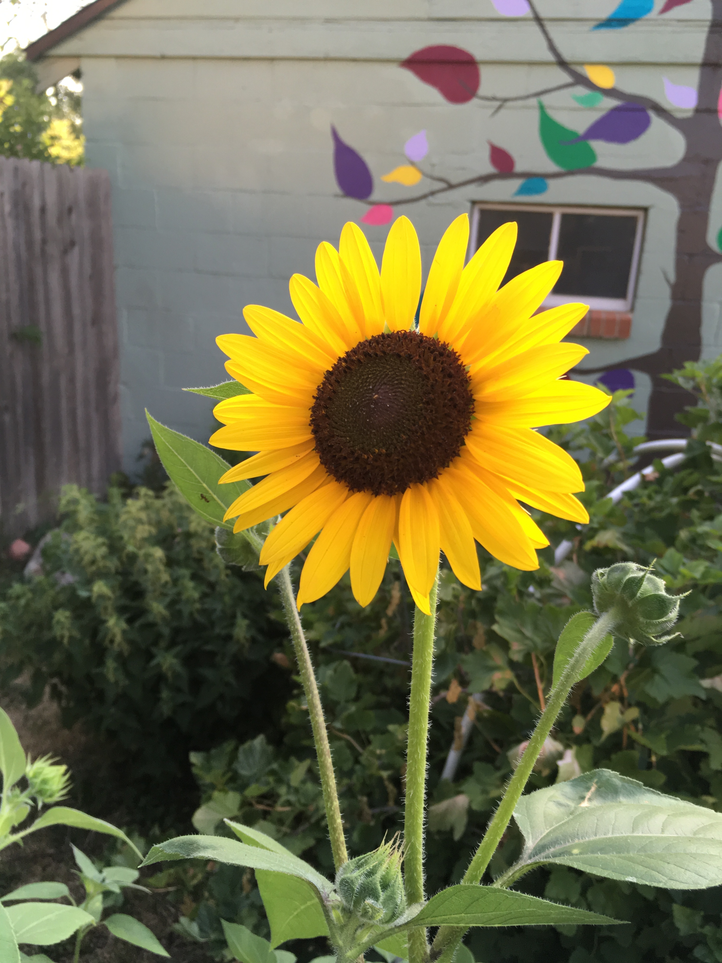
Garden Spirituality recognizes the green world as Sacred
We can choose to honor that awareness in an intentional way, interacting with gratitude and care as we engage with the interconnected web of life.

Slide 9
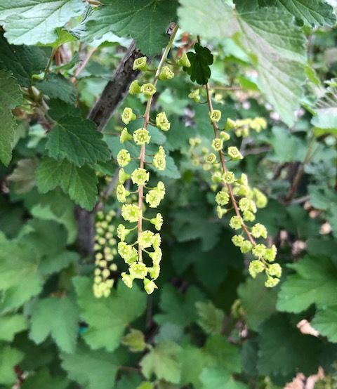
Practices & Challenges
Noticing & Interacting
Welcoming & Gratefulness
Engaging with Plant Energies & Stories

Slide 10
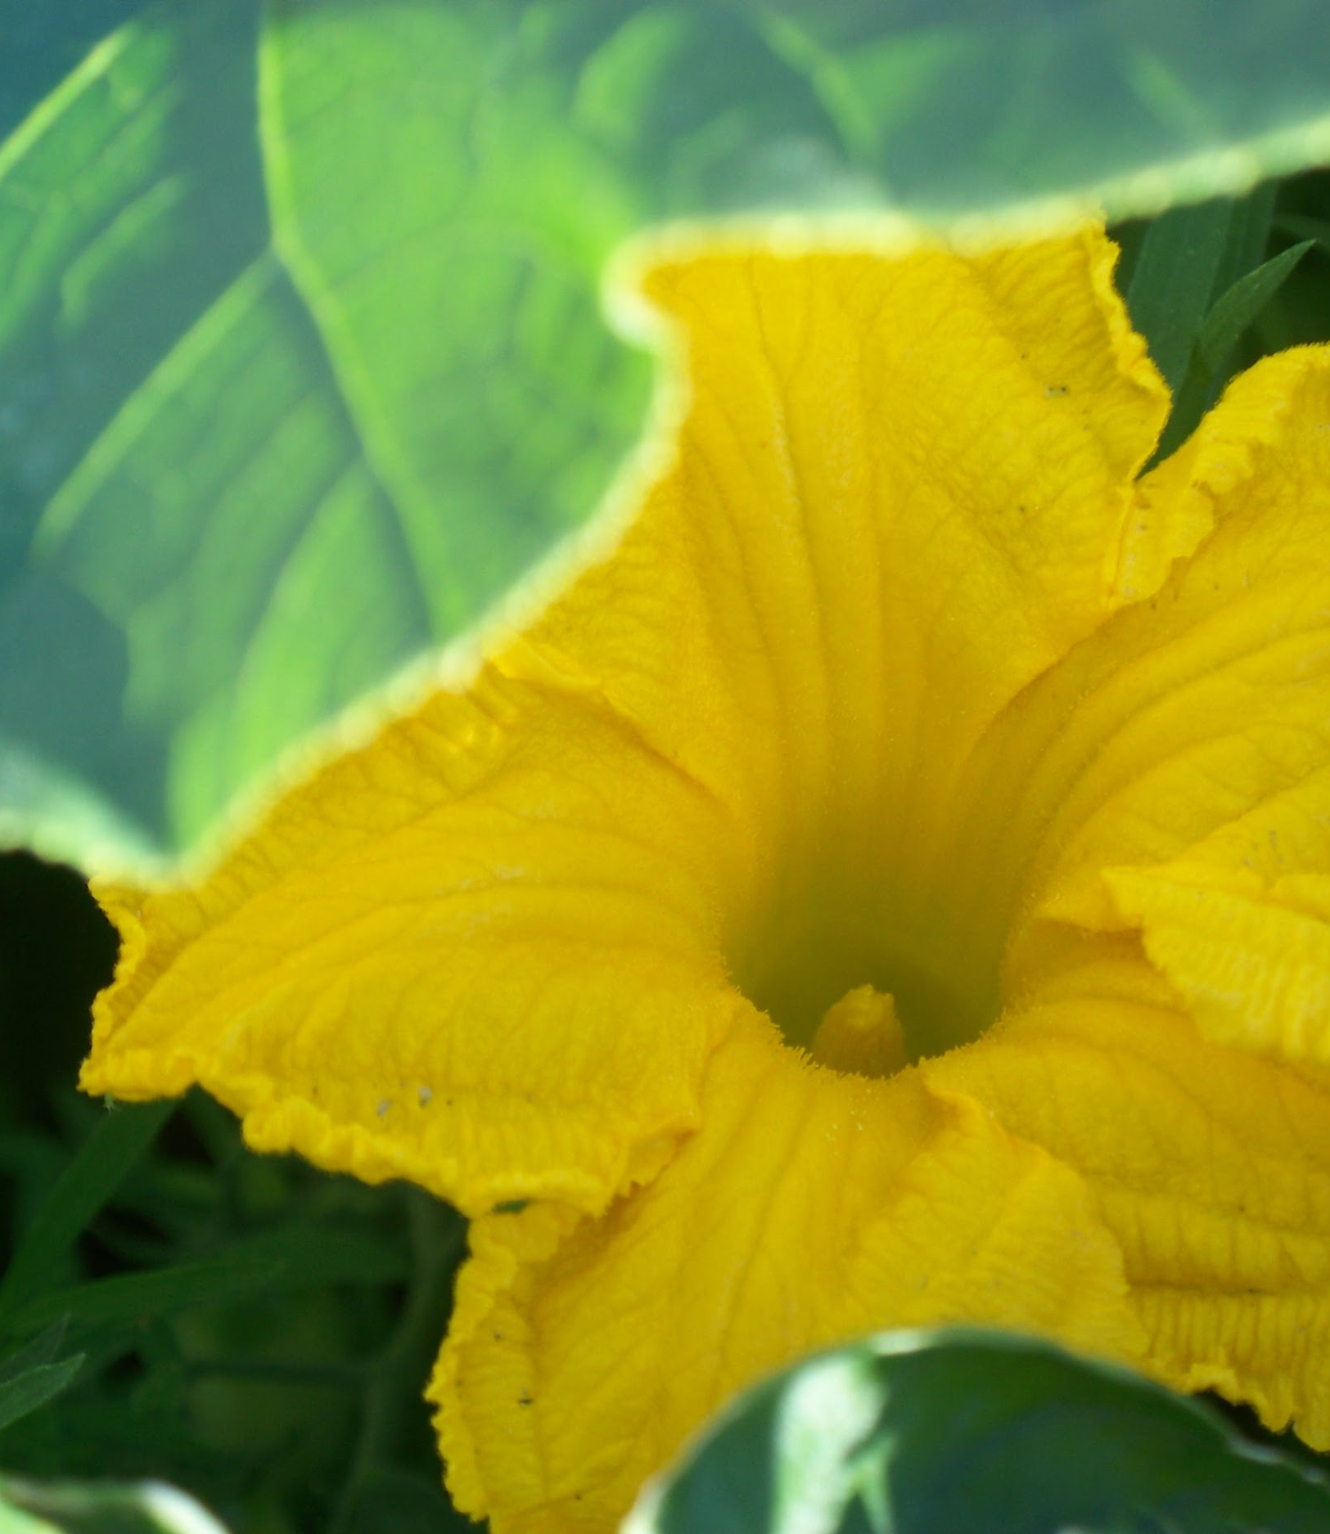
Practice #1 Grab your Journal
What are we really seeing?
Notes:
three activities : draw draw write

Slide 11
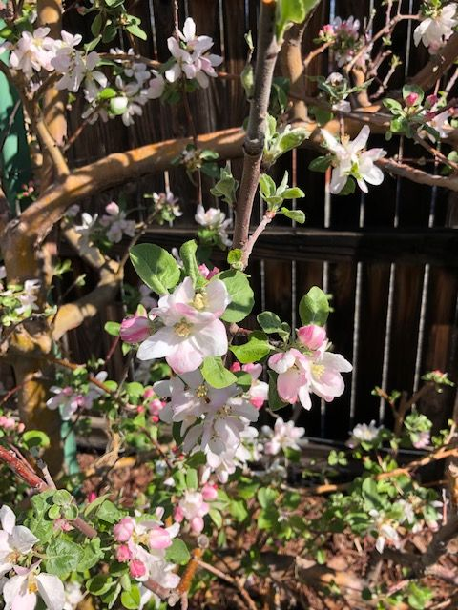
Challenges with Practice #1
Compare Memory to Reality
Make an 8 week commitment to work with one tree or plant in this way.

Slide 12
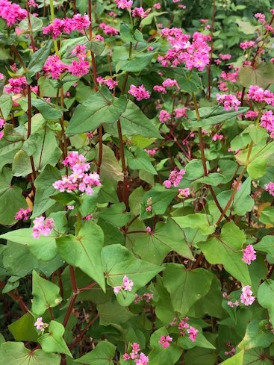
Practice #2 Embracing morning/evening garden energy
Simple garden qigong

Slide 13
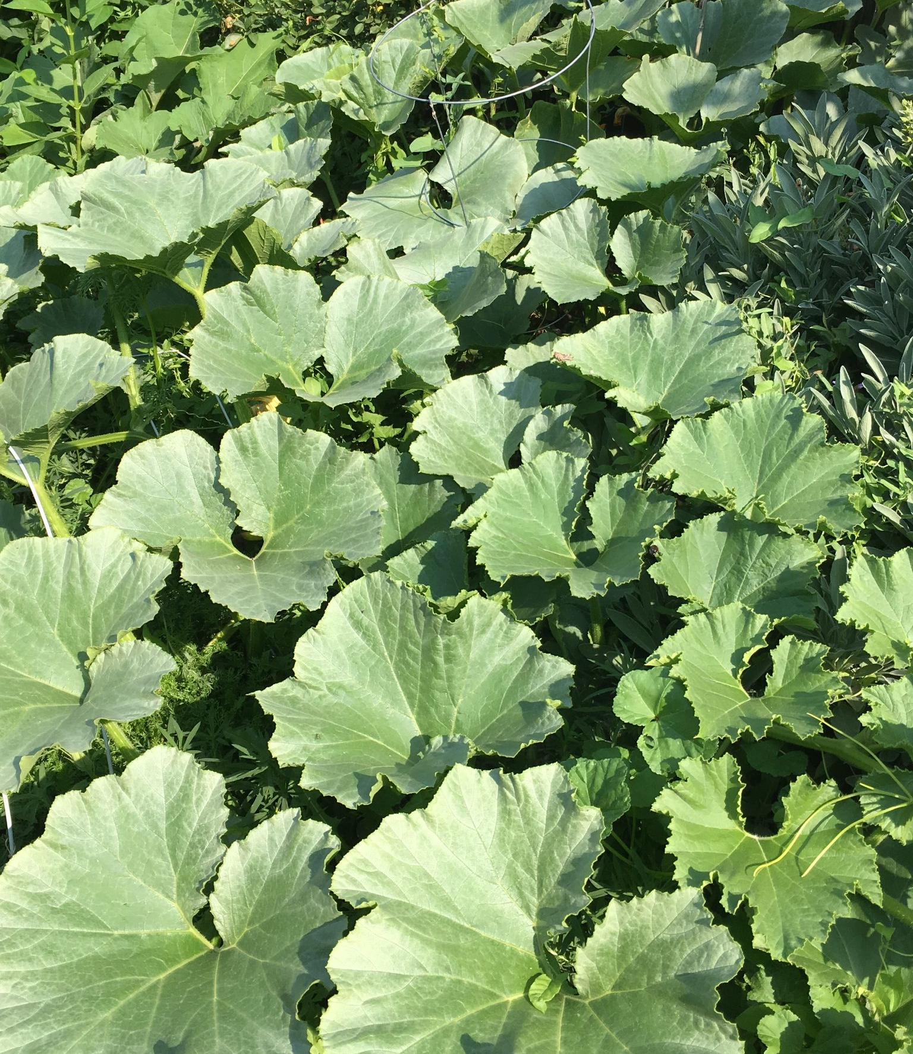
Practice #2 Challenges
Adopt this practice for at least seven days. Choose morning or evening or both.
Make a commitment and see what happens

Slide 14
Many Paths to Relating to Plants as Teachers -Plant Energies -Plant Stories -Plant Allies -Ancestor connections

Slide 15
Practice # 3 Working with PLANT CORRESPONDENCES
The energetic characteristics of plants that we can work with in various ways as spiritual practices

Slide 16
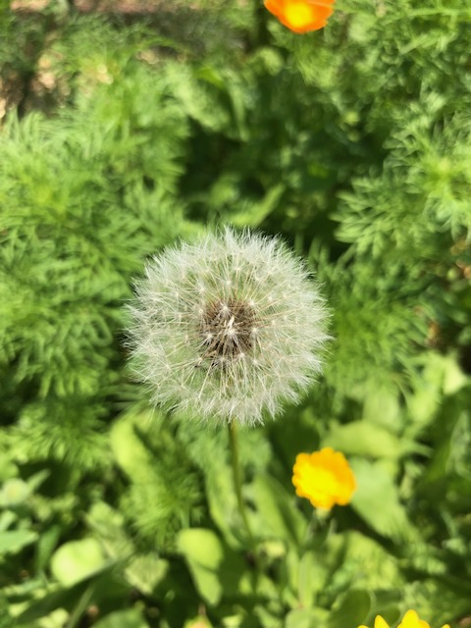
One More Poll

Slide 17
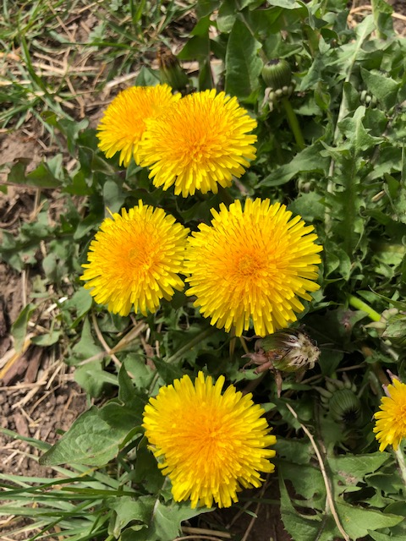
Dandelion Energy of Resilience
A healing plant that helps our bodies be resilient
Inventive at finding ways to survive and thrive

Slide 18
Journal Prompts
What does dandelion energy mean to you?
In what ways do you relate to dandelion’s energy of resilience?
What parts of the dandelion’s strategies of resilience could you adopt?
In what ways might you welcome dandelion energy into your life?

Slide 19
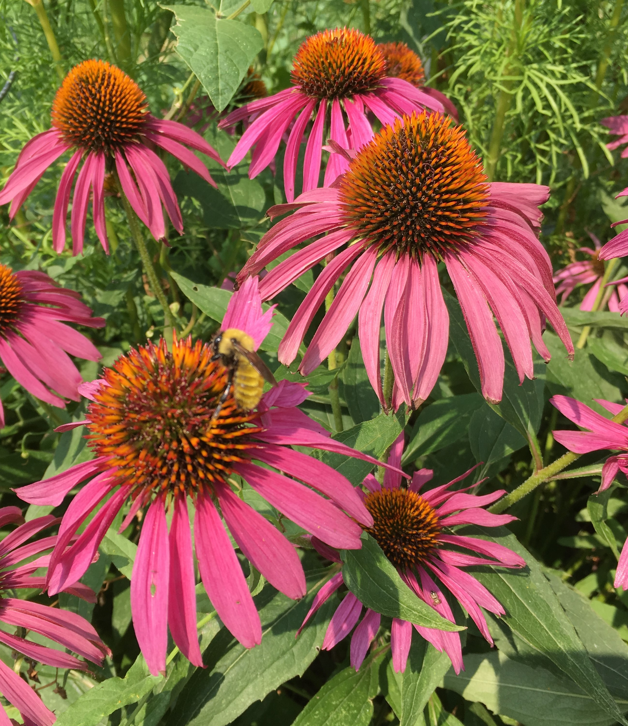
Challenge
Identify one to three plants you have an affinity with and want to learn more about.

Slide 20
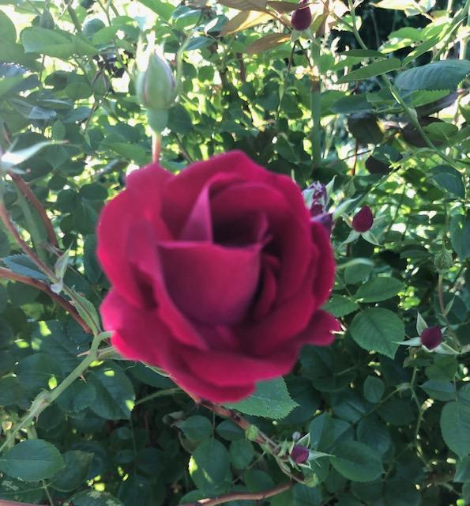
Another Aspect of Plant Wisdom
The Ancestor Connection

Slide 21
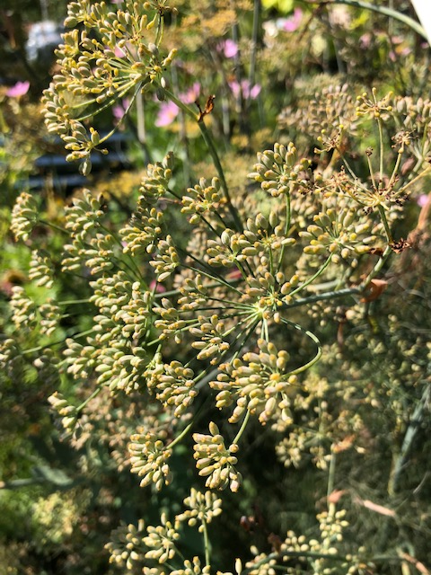
Plant Stories that Inspire
Fennel and Illumination

Slide 22
Final Thoughts
The green world is sacred.
It is our home and our life support
We can engage with green energy in a myriad of ways that deepen our connection, wisdom, and wellness.
Simply begin to pay attention and put some of the practices into play.

Slide 23
More Information
Email me at: Joanncalabrese@gmail.com
Or joann@cmwn.org
My website: mindfulnessgardengames.com with a blog on garden mindfulness and other information

