Slide 1
Social Justice Branding and Design
ART+ for Social Justice
AltCon22
November 3, 2022
6:00 PM – 7:00 PM EST
Jen Padron, CPS, M.Ed, MSWc

Slide 2
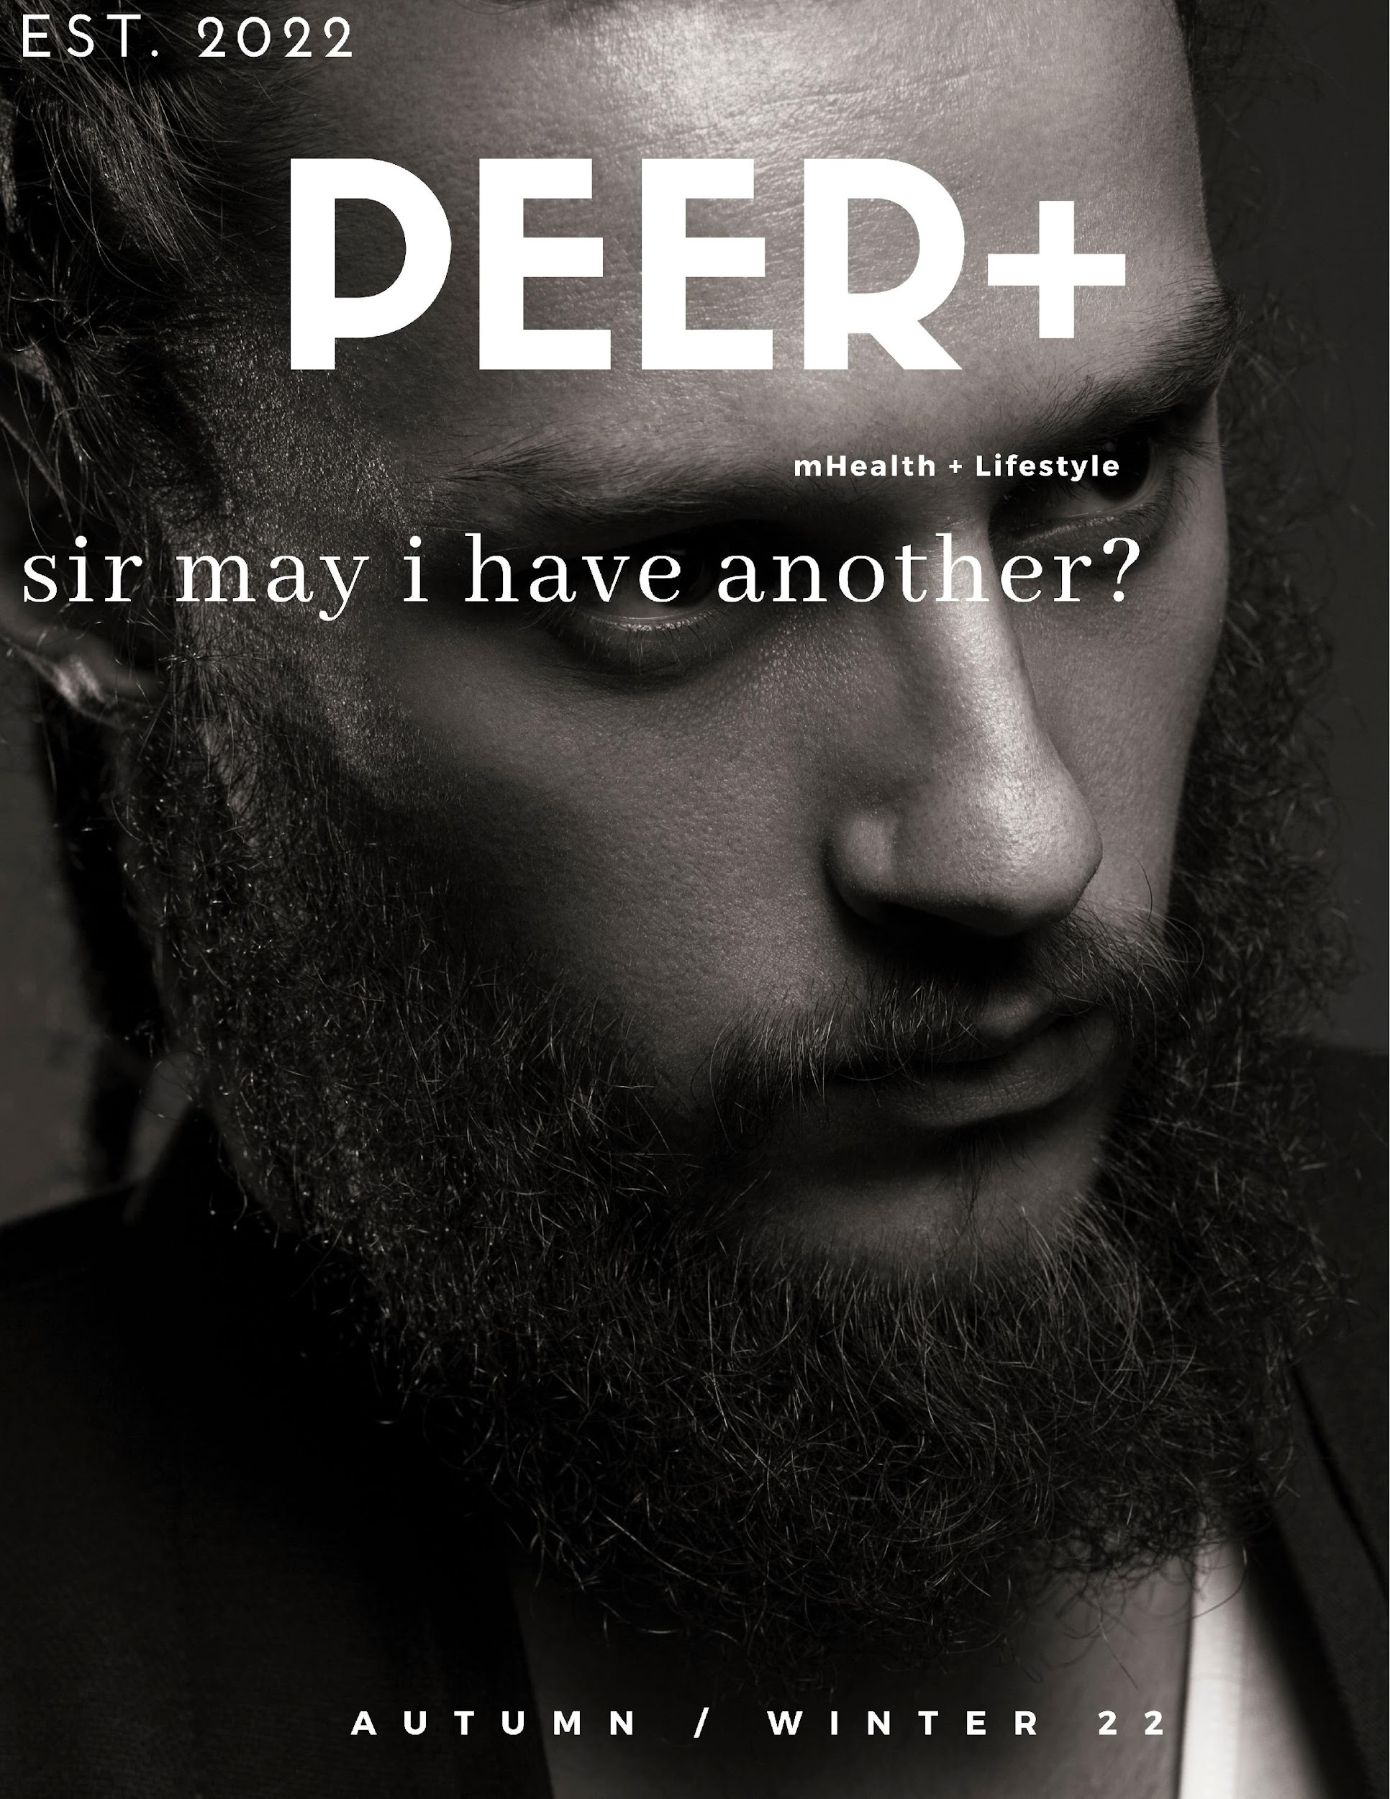
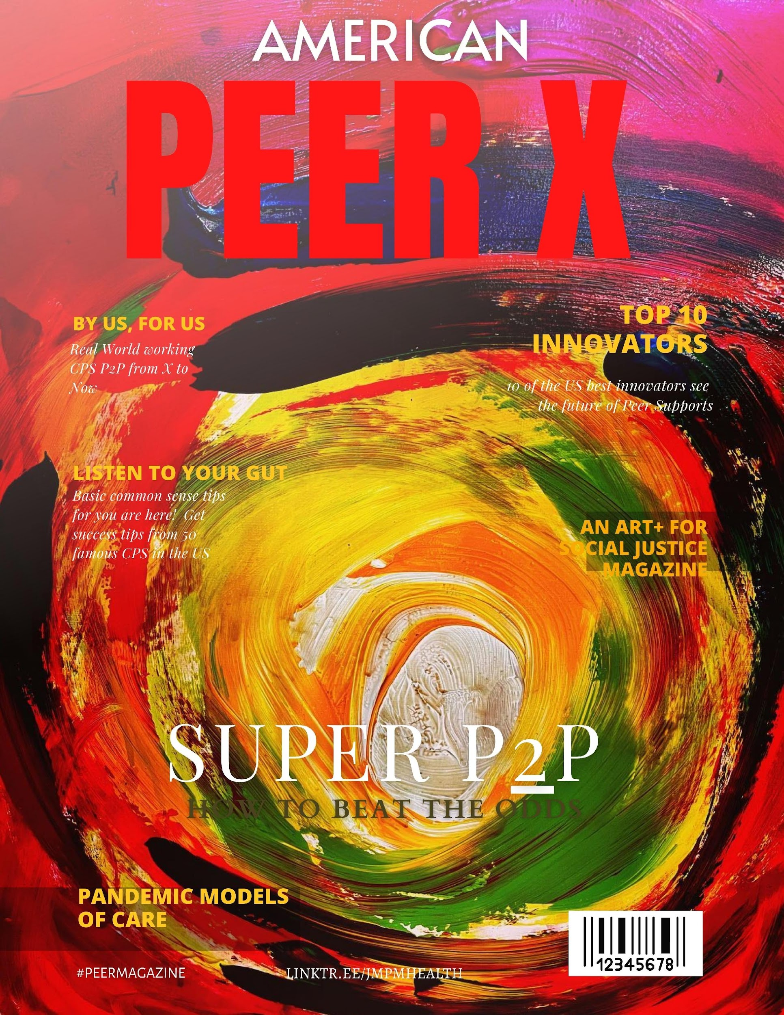
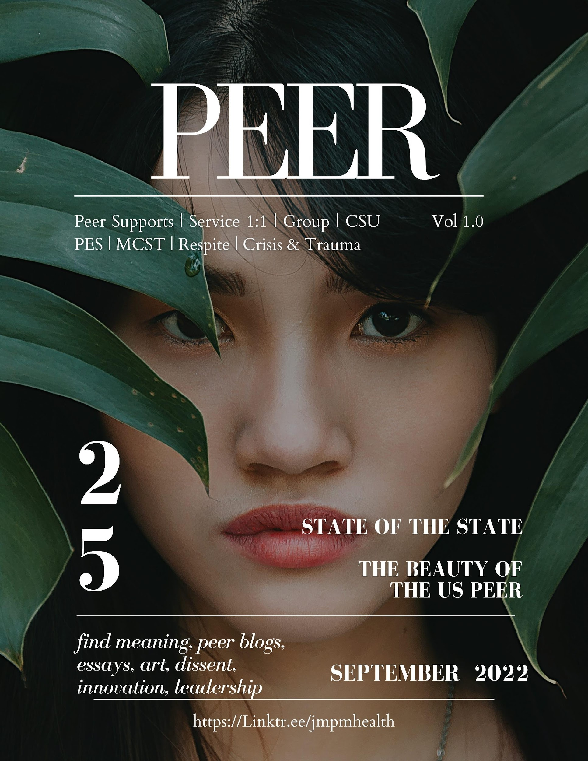
Branding
Surviving Race: The Intersection of Injustice, Disability and Human Rights
2020-2022 SARS COVID19 Surviving Race Community Care Peer Support Network
Dialogues & Retreat 2021-2022
What’s your message?
What is your product?
What’s your Goal?
What’s your Vision?
Is there current branding (e.g., color, font, format, precise placement by provider)?

Slide 3
Messaging
“Build it, and they will come” only works in the movies. Social Media is a “build it, nurture it,“ engage them and they may come and stay.
Seth Godin, Founder, Squidoo
“Content is fire, Social Media is gasoline.”
Jay Baer, Founder,
Convince & Convert
Consulting
“I use social media as an idea generator, trend mapper, and strategic compass for all of our online business ventures.”
Paul Barron, Founder and CEO, Paul Barron Group and Rever Network Inc.
1
2
3
“Social media is here: it’s not going away, not a passing fad. Be where your customers are: in social media.”
Social Media Marketing (22)

Slide 4
Choose Your Weapon
Social Media
Impact
Nov. 2022
Jan.–Feb. 2023
Facebook
Instagram
Twitter
Pinterest
LinkTree
Media (Print/Digital)
Dec. 2022
Messaging Onslought
KISS (Keep It Simple, Stupid)
Make it Purty
Make it Hot
Get your message across using Image & Content.
Do not preclude Image/Sound permeating messages

Slide 5
2020-2022
ART+ for Social Justice Art & Design 20-22
Compendium Volumes I-X
Amazon & Kindle 22
Jen Padron Imagery
Surviving Race: The Intersection of Injustice, Disability and Human Rights
https://linktr.ee/jmpmhealth
https://linktr.ee/survivingrace
https://covid19careguide.net/
https://www.facebook.com/groups/364074427086419
https://fineartamerica.com/profiles/jennifer-padron?tab=artworkgalleries&artworkgalleryid=1084468
https://studio.youtube.com/video/y4qx1O8dsFQ/edit
https://pandemicwellness.guide/
Linktree
Surviving Race, The Pandemic Years
@PEERzine

Slide 6
You’re only as effective as your Network
SARS COVID19 SRCCPSN.NET
Psychiatric Oppression
Queer Pride
My ART+ for Social Justice (Creative)
PEER Magazine
Surviving Race (Choice, Non-Coersion, Stop the Killings)
I’m inherently a peer. Organizer. Activist. Advocate. Certified Peer Specialist. Crisis. Trauma. SI/HI.

Slide 7
It’s up to you. Your imagination is endless. Make it Count.

Slide 8
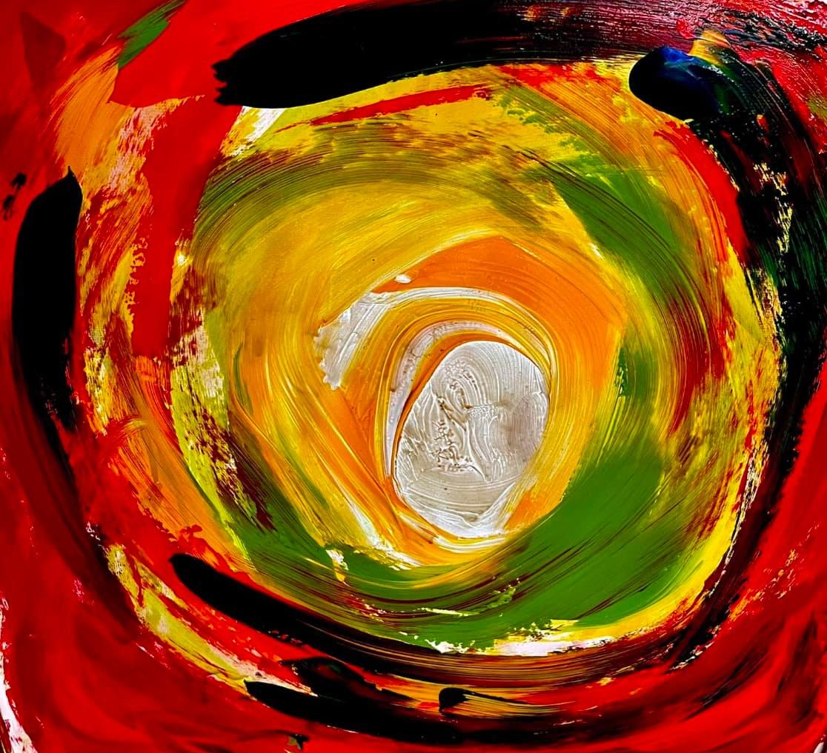
Create. Make. Collaborate. Partner. Network.

Slide 9
For More Information
linktree
ART+ for Social Justice
(706) 391-3864
email me

