Slide 1
Our Future is in Our HANDS
An Arts Approach to Wellness
Gayle Bluebird, Peer Arts Consultant

Slide 2
The Importance of Our Hands

Slide 3
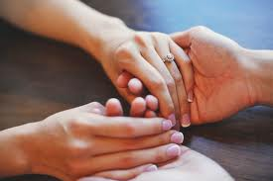
The Importance of OUR HANDS
“Our hands do so much for us. They are capable of a wide variety of functions; grasping, feeling, touching, holding, manipulating, caressing, and more. They are a vitally important part of who we are and how we see ourselves!”
Dr. Douglas Smith, MD
Orthopedic Surgeon, University of Washington

Slide 4
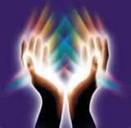
Reflexology With our Hands
Reflexology is a technique that is recorded throughout the time of history, originating with the Egyptians, who demonstrated creative ingenuities with their hands including cosmetics, the great pyramids, and understanding the correlation between massage and how it effects the mind/body experience.

Slide 5
OUR HANDS ALSO SPEAK TO OUR BODIES INTERNALLY
Each muscle is connected to a nerve…
When massage is given in the correct manner, that stimulation effects a nerve which affects the organs/systems in our bodies.
This proper stimulation can improve and promote healing in our bodies.
Notes:
Which in turn typically produces a positive outcome for our mind and bodies

Slide 6
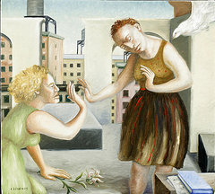
The Importance of Touch:
Humans have an innate need for contact--for physical touch. But is there greater spiritual significance to touching?
Modern language contains many expressions that convey the importance of touch.
Many of us live in societies that shun actual physical touch. Sociologist Ashley Montagu observes that we in the Western world "have produced a race of untouchables."
Notes:
For example: We speak of friends and acquaintances "staying in touch." We describe some people as being "out of touch." We sometimes say that a tactless person has "a heavy touch.“ Montagu says, He sees this as a sign of the "impersonality of life.“Others agree that the Western world suffers from touch aversion and believe that part of the cause is our addiction to gadgets such as computers and television.

Slide 7
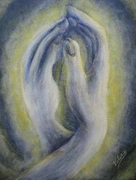
A Touching Need
The most basic element of love is physical touch. Typically, the first action a mother takes toward her newborn is to pick up her infant and hold it close. This is vital to the baby in that it triggers the crucial bonding process for the newborn.
As Montagu says, "Among the most important of the newborn infant's needs are the signals it receives through the skin, its first medium of communication with the outside world."
Notes:
As the child grows, one of its greatest needs "if it is to prosper...is to be handled, and carried, and caressed, and cuddled, and cooed to..." A child who is completely deprived of such loving treatment may not survive.

Slide 8
What Our Hands Communicate:

Slide 9
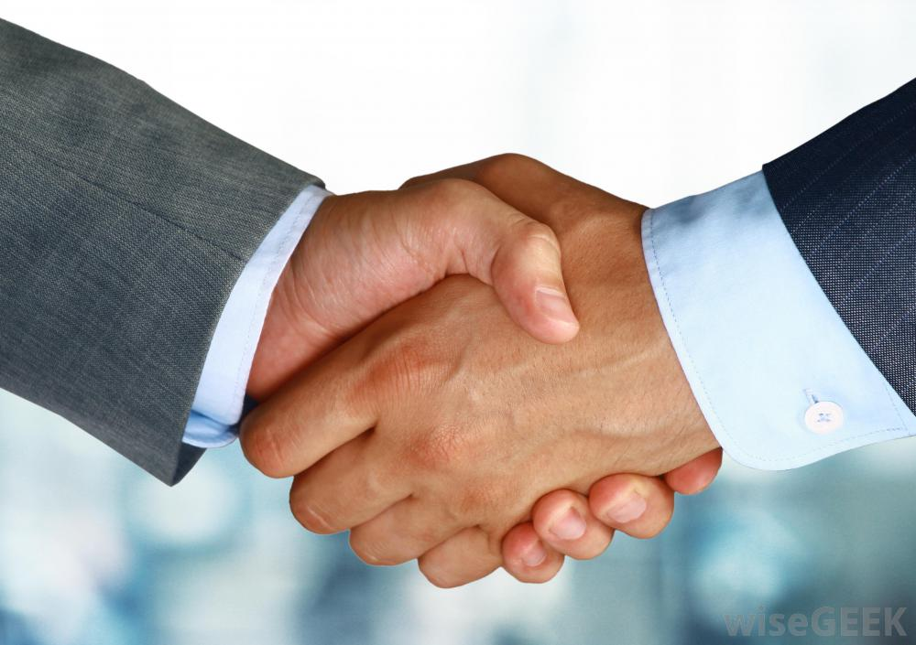
What Our Hands Communicate:

Slide 10
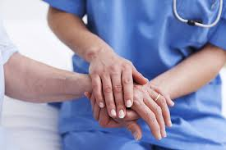
What Our Hands Do

Slide 11
WHAT OUR HANDS SAY
Notes:
Holding Hands Brings us closer to connect and bond.
Mother and child.

Slide 12
Famous Artists Using Hands

Slide 13
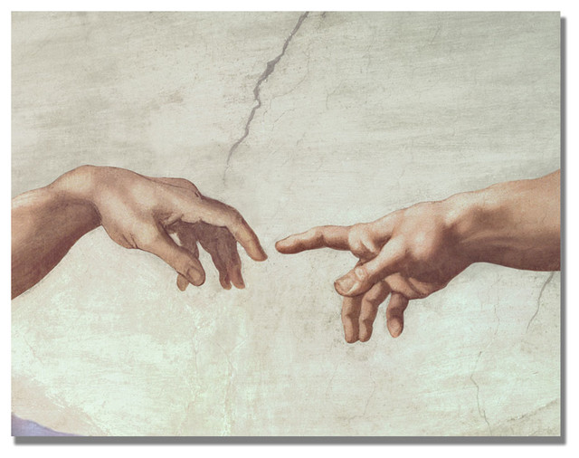
Michelangelo 'Hands of God‘
Few artists have captured the physical human form with the beauty seen in Michelangelo's work, even in the smallest of details. In this close-up mural of his Creation of Adam, part of his Sistine Chapel fresco masterpiece, we see just two hands, God's reaching down to Adam's, their fingers almost touching. God's hand is full strength and energy, while Adam's hand seems to wait for that electric spark of life.

Slide 14
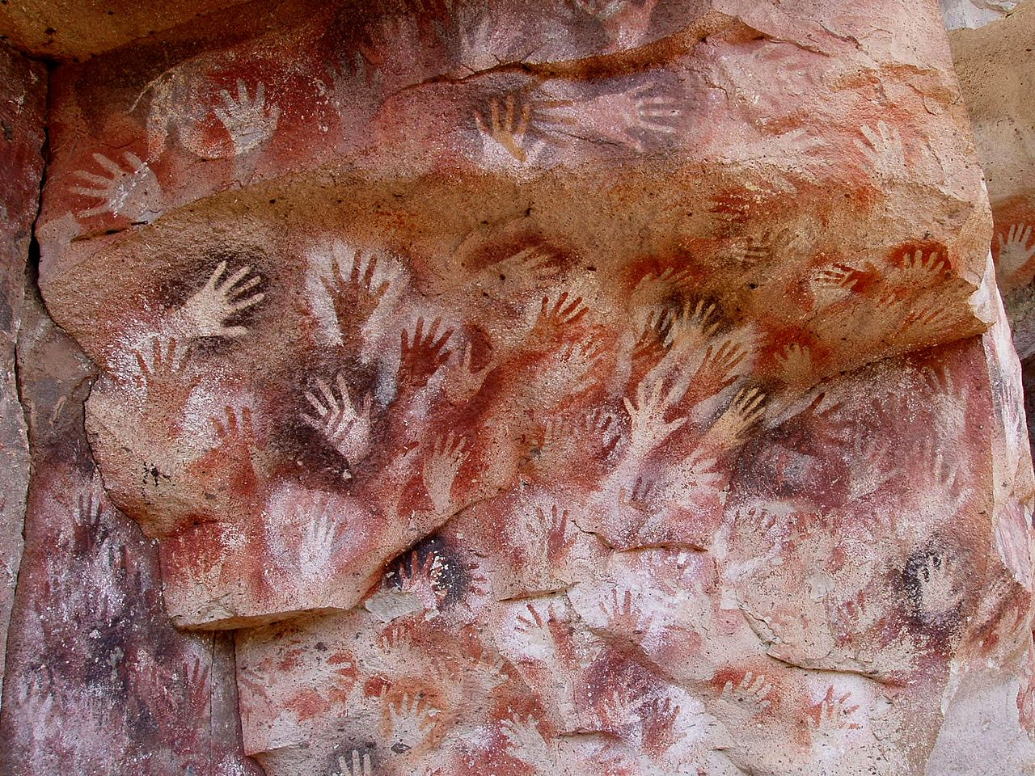
Cueva de las Manos (Cave of the Hands) is a cave in Argentina. The art on the walls of the cave dates from 13,000 to 9,000 years BC. The early artwork has been carbon-dated to ca. 9300 BC. The age of the paintings was calculated from the remains of bone-made pipes used for spraying the paint on the wall of the cave to create hand silhouettes. Because the hands are mostly left hands, scientists believe that the painters held the spraying pipe with their right hand

Slide 15
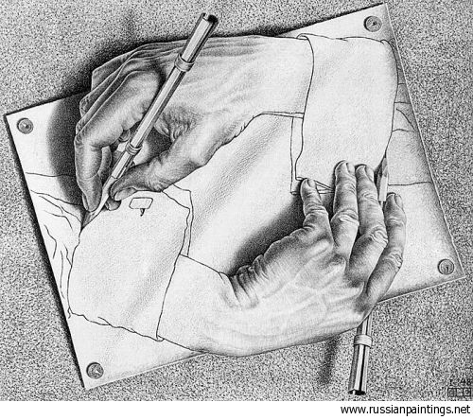
Escher Maurits Cornelis - 'Drawing Hands‘
Maurits Cornelis Escher (1898-1972) is one of the world's most famous graphic artists. His art is enjoyed by millions of people all over the world, as can be seen on the many web sites on the internet.
He is most famous for his so-called impossible constructions, such as Ascending and Descending, Relativity, his Transformation Prints, such as Metamorphosis I, Metamorphosis II and Metamorphosis III, Sky & Water I or Reptiles.

Slide 16
Other Arts Activities (from grade school students)

Slide 17
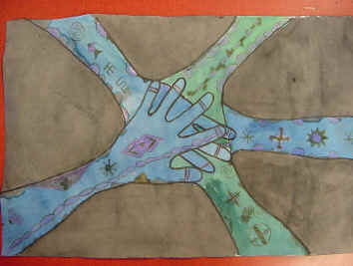
Adinkra-Meets Mehendi Hands Designs by Christine Besack
A very interesting cultural mix! Students learned about two cultures in the creation of these hand designs. Adinkra symbols were studied along with their meanings. Students combined these symbols and their own personal symbols with the elaborate designs of Mehndi (also Mehendi) henna decorations. Students did tracings of their hands. Overlapping in an interesting way was suggested.

Slide 18
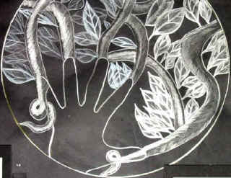
"Sacred Circles" Mandalas
image from Gina Grant Clifton Hill Primary
Quoted from Bunki Kramer: The lesson comes from a book called Mandala: Luminous Symbols for Healing by Judith Cornell, PH.D. who is from San Francisco. It discusses the spiritual light from within the self which comes from ALL religions and encompasses the circle as the common ground for all religious artworks. It doesn't just cover eastern philosophies but ALL philosophies of religion.

Slide 19
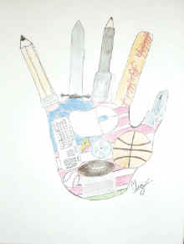
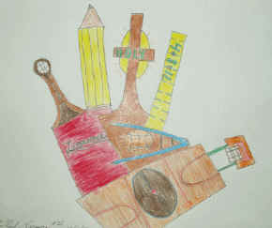
Surreal Self Portrait Hands
Submitted by Carol O'Neil
This lesson is modified from one by Bunki Kramer. Student created a surreal portrait of themselves using their hands and symbols representing their interests.

Slide 20
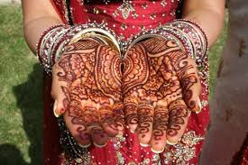
Henna Art Project
This Henna Hand Designs Art Lesson shows you how to create a unique and unusual self-portrait of your hands!
** EXPLORE **
• Other cultures
• The role of pattern in abstract art
• How to create abstract patterns
• How to express themselves in a symbolic way

Slide 21
With These Hands…

Slide 22
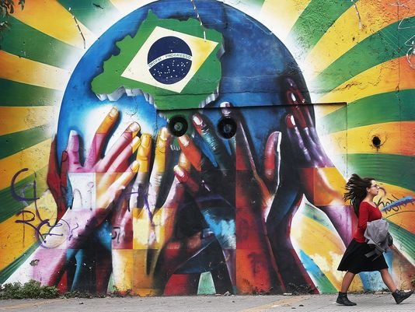
The Brazil 2014 World Cup

Slide 23
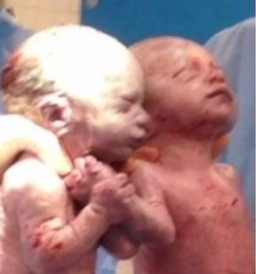
Mono Babies Born Holding Hands
May 11th, 2014
The identical twin girls shared the same amniotic sac and placenta. Such births are called monoamniotic, or "mono mono," and doctors say they occur in about one out of every 10,000 pregnancies.
CBSNEWS.com

Slide 24
Quotes on Hands

Slide 25
Quotes on Hands:
As you grow older, you will discover that you have two hands, one for helping yourself, the other for helping others.
Audrey Hepburn
Sometimes if you want to see a change for the better, you have to take things into your own hands.
Clint Eastwood
The final forming of a person's character lies in their own hands.
Anne Frank
I have held many things in my hands, and I have lost them all; but whatever I have placed in God’s hands, that I still possess.
Martin Luther King JR

Slide 26
With Our Hands
(From Other Arts Workshops)

Slide 27
PEER EXAMPLES (FROM OTHER ARTS WORKSHOPS)
ASHLEY WELTON
FRANZSWA WATSON

Slide 28
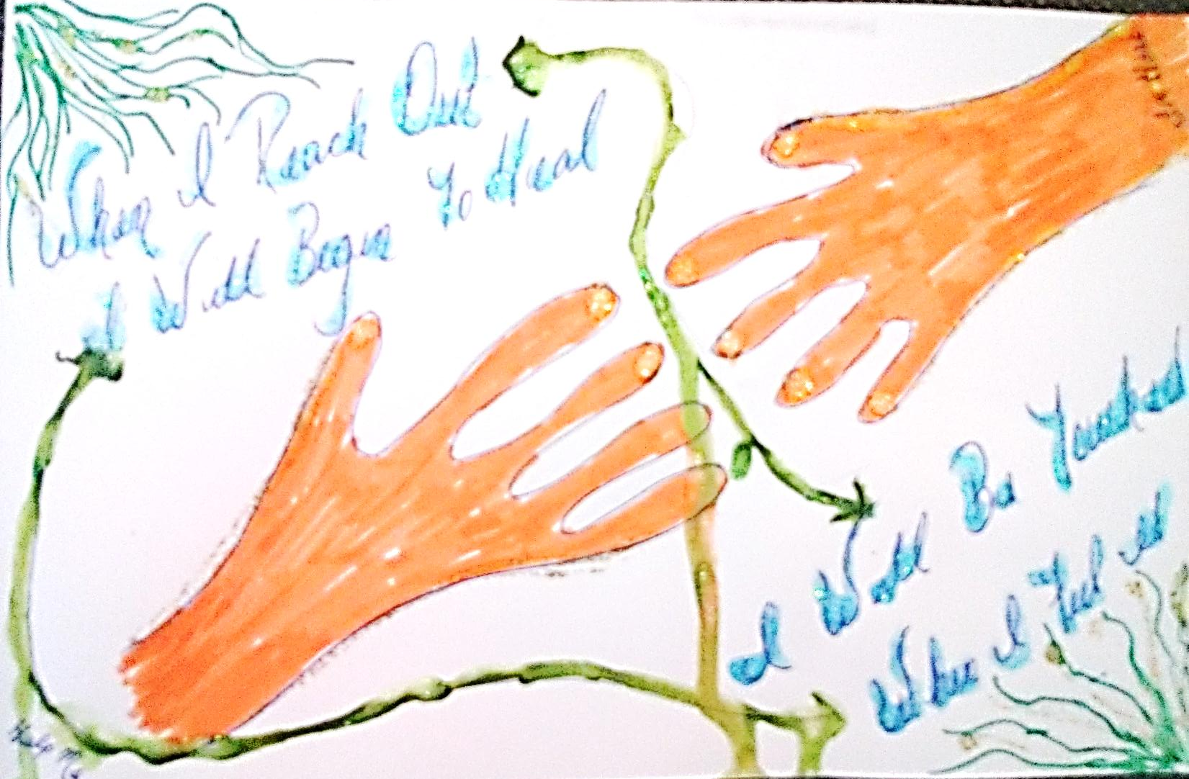

Slide 29
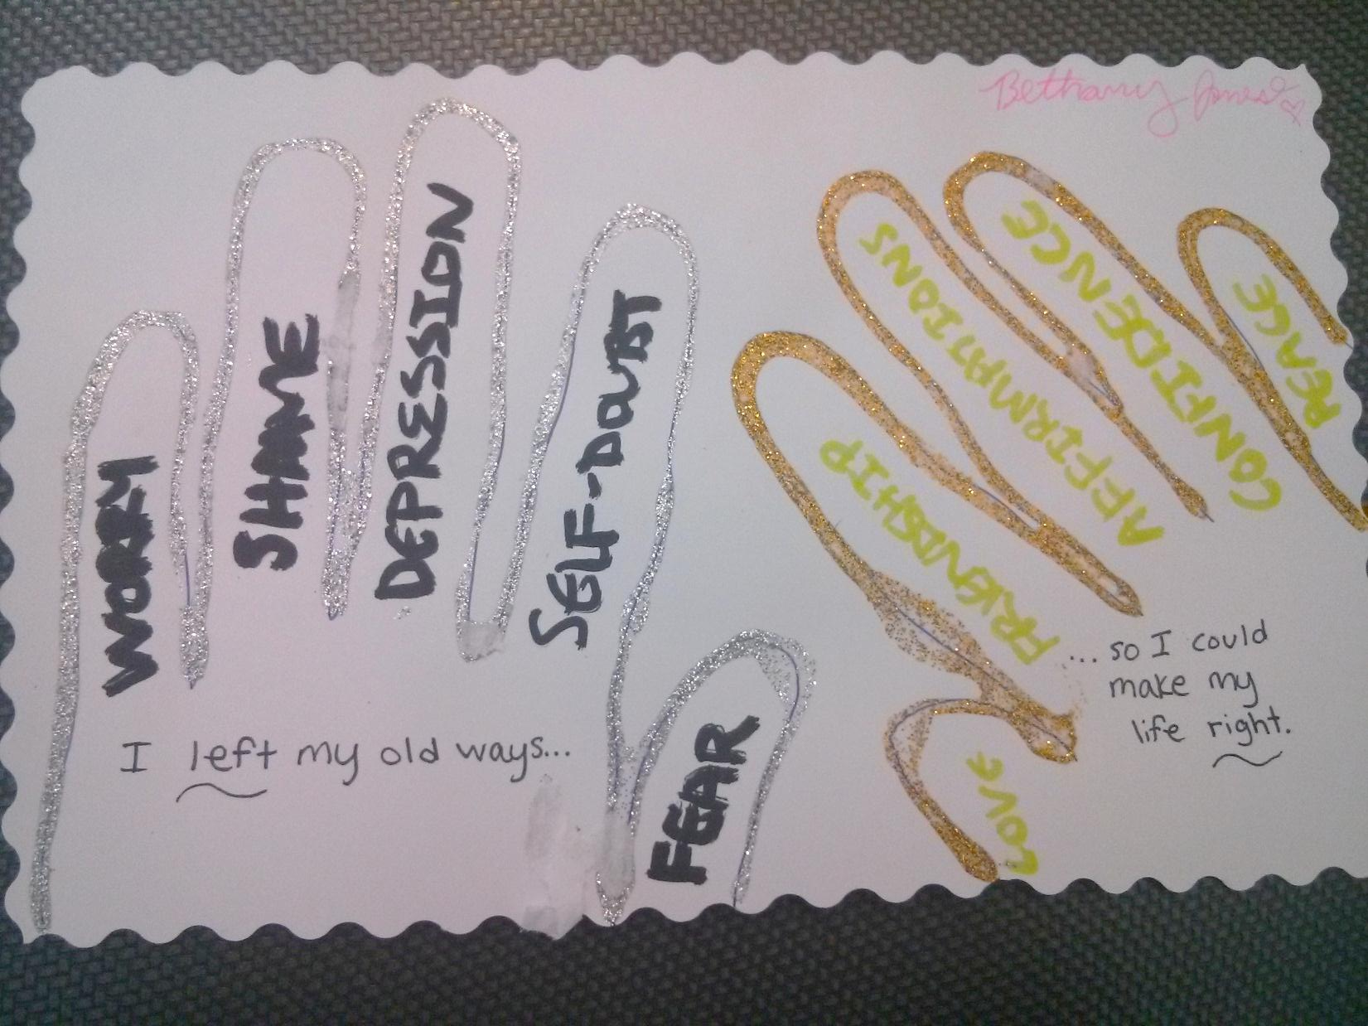

Slide 30
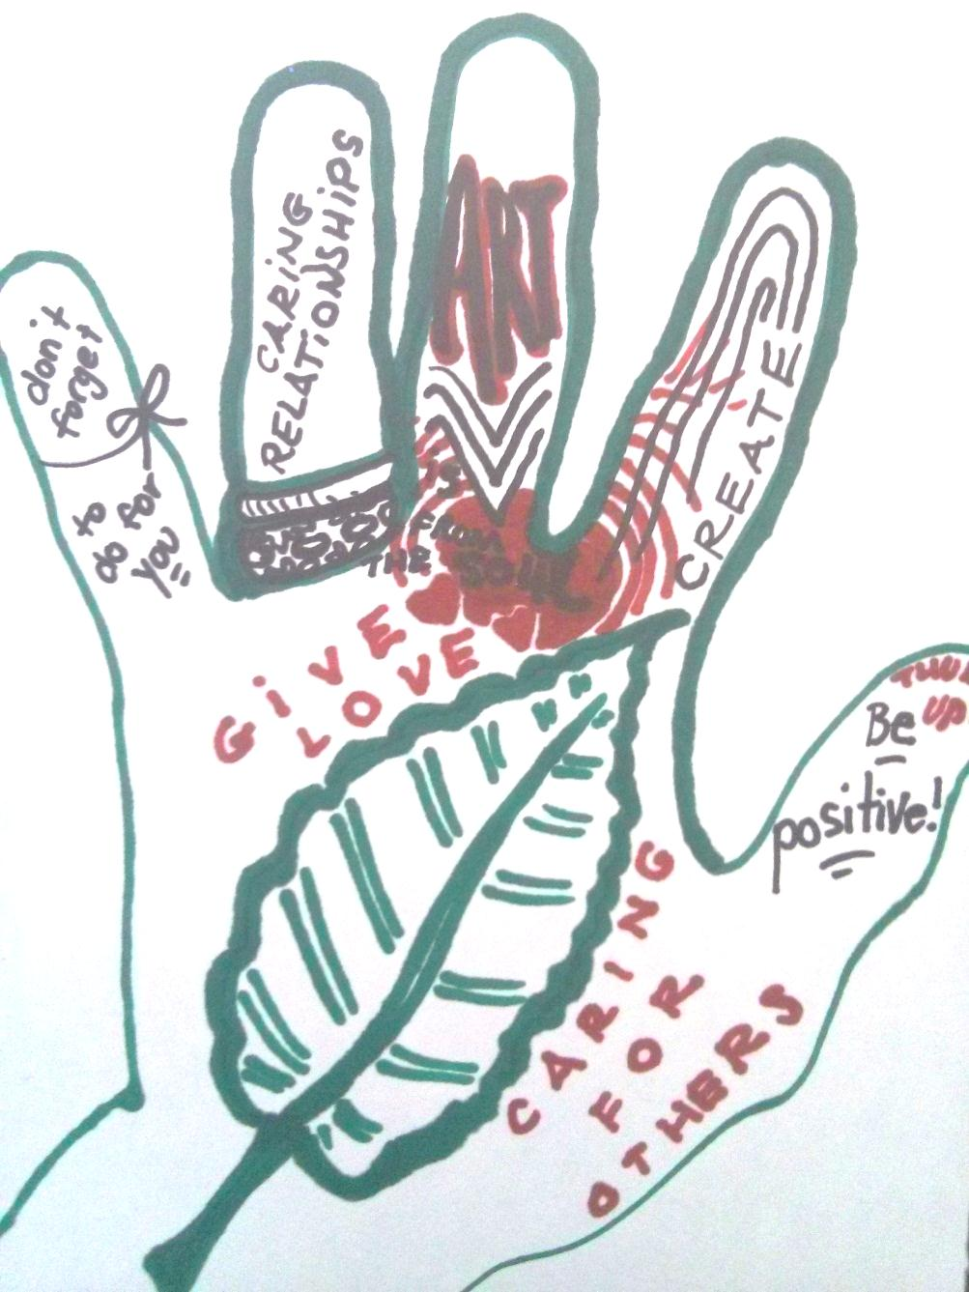

Slide 31
What Do Your Hands Mean to You?

Slide 32
OUR EXERCISE TODAY
LEARNING FROM EACH OTHER THROUGH THE VARIOUS MEANS OF COMMUNICATION WITH OUR HANDS, ALLOWS US TO SHARE OUR INNER EXPERIENCES THROUGH ARTISTIC TECHNIQUES IN OUR RECOVERY JOURNEY.
THINK ABOUT WHERE AND HOW, YOUR HANDS HAVE HELPED YOU THROUGH YOUR RECOVERY EXPERIENCE
EXPRESS AND SHARE YOUR ARTISTIC RECOVERY JOURNEY TODAY, THROUGH MEANS OF YOUR “ARTISTIC” HAND.

Slide 33
THANK YOU & GIVE YOURSELVES A “HAND!”
CONTACT INFORMATION
Gayle Bluebird, Director of Peer Services
Delaware Psychiatric Center – New Castle, De
gayle.bluebird@state.de.us 302-255-2701
Franzswa Watson, Peer Educator/Trainer
Delaware Psychiatric Center – New Castle, De
Franzswa.watson@state.de.us 302-255-9731

Slide 34
Resources
www.incredibleart.org
http://www.alteredstatesofthearts.com/
http://www.sbyfproject.com/
http://www.muralsyourway.com/hands-of-god-adam-mural/
http://www.mcescher.com/about/biography/
http://www.ucg.org/faith/touch-man-and-hand-god/

Slide 35
Participating in Gayle Bluebird and Franzswa Watson’s "Recovery Is In Your Hands" workshop was absolutely the highlight of the 2014 On Our Own of Maryland conference for me. Listening to Bluebird's presentation about how our hands can be the source of healing and growth sparked my creativity and curiosity. It was especially engaging to create artwork on the theme of hands and recovery.
Drawing on Bluebird's eloquent call to action, I drew a multicolored hand decorated with meaningful recovery quotes and sun and moon images to represent mania and depression. I came away from Bluebird's workshop feeling refreshed and energized - this session was, "hands down," a breath of fresh air!
- Shannon Flynn Lewis, MA

