Slide 1
Using everything gleaned from 30 Years in our Human Rights Movement, Healing Practice Communities and my faith...
Phillip Schulman, CHB

Slide 2
BEFORE

Slide 3
Before
(w/ brother Michael)

Slide 4
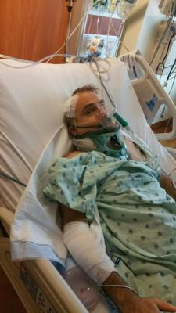
ICU
Notes:
OY, MY HEAD!

Slide 5
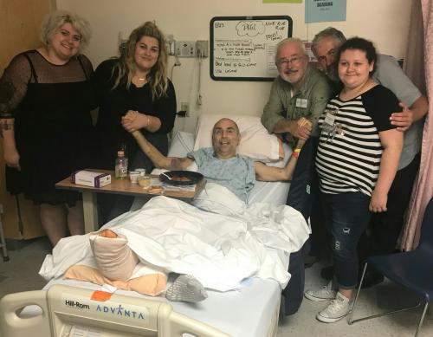
Family & Friends
Notes:
LOVE, FRIEND SUZY; FAMILY THANKSGIVING.

Slide 6
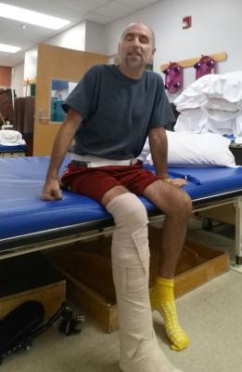
R
e
h
a
b
Notes:
REHAB PATIO; REHAB THERAPY

Slide 7
Former congregant visits from TX!
Notes:
TX UU VISIT

Slide 8
First
Time Standing
Notes:
FIRST TIME STANDING

Slide 9
Concert on
Rehab patio
Notes:
CONCERT; COMMUNITY LOVE

Slide 10
Florida sunshine, rehab hospital patio
Notes:
HOME!

Slide 11
1st outing February 2018
Notes:
VEG FEST IN MARCH

Slide 12
March
April
Notes:
HOME IN MARCH AFTER 4 MONTHS
LIFTING WEIGHTS IN APRIL

Slide 13
May
Notes:
WALKER BY MAY

Slide 14
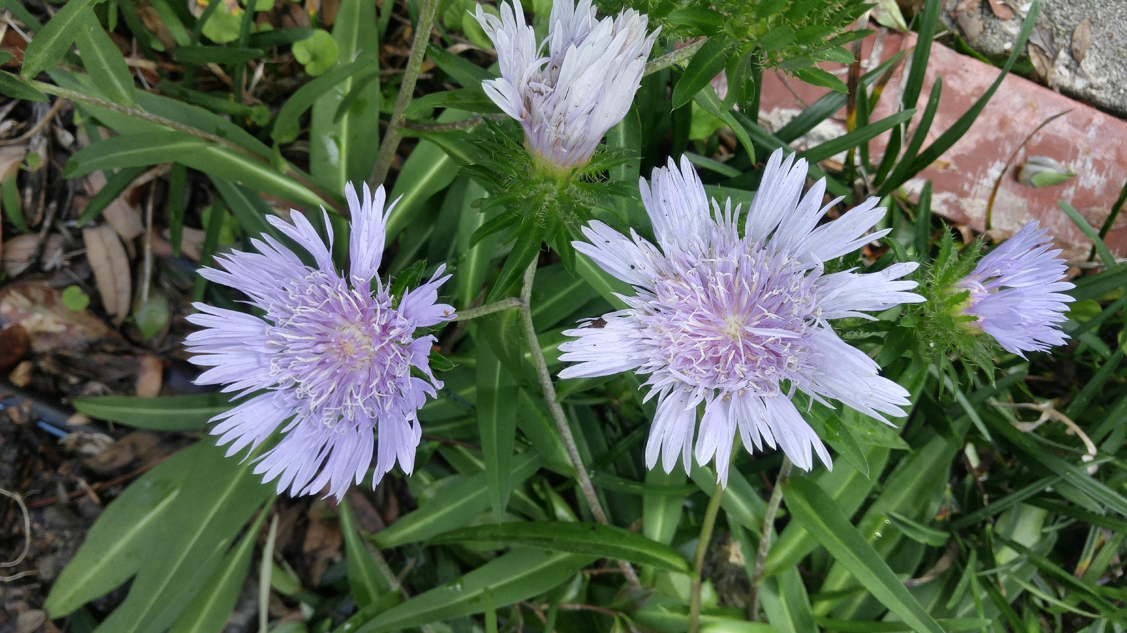
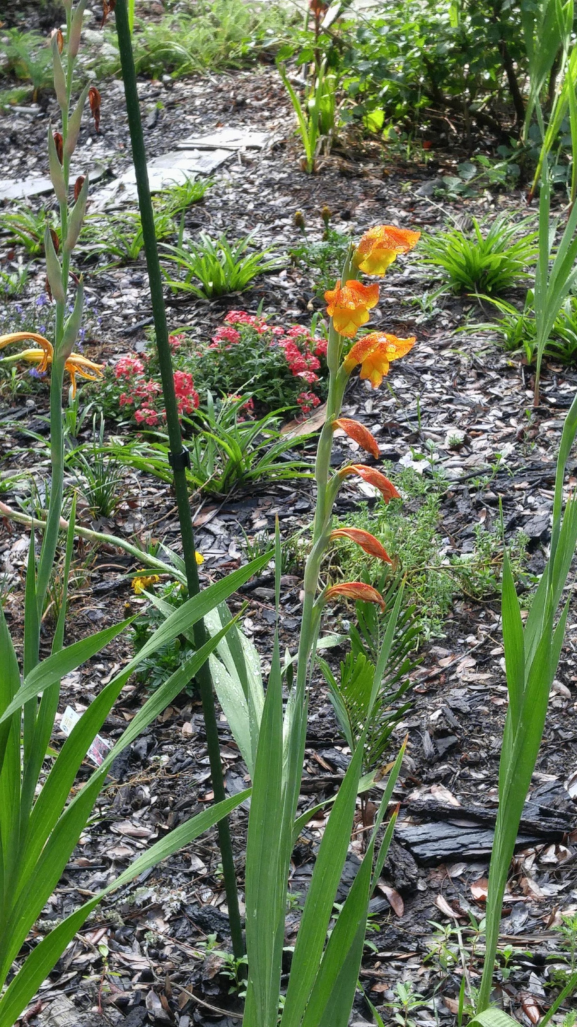
N
Gardening, soul therapy

Slide 15
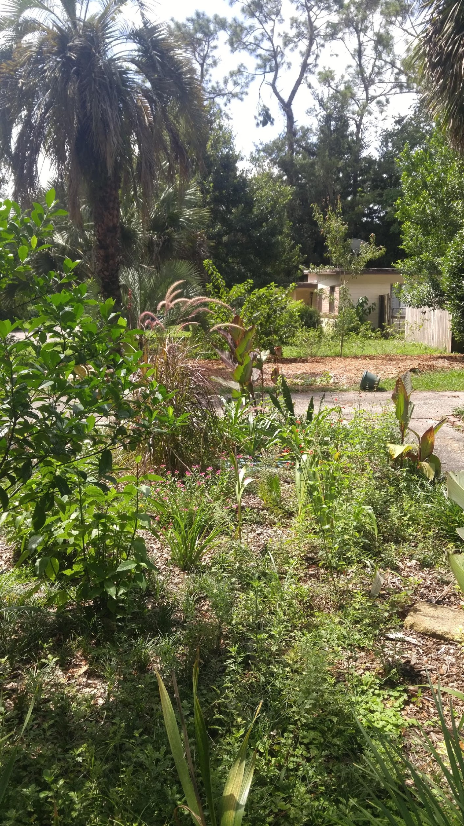
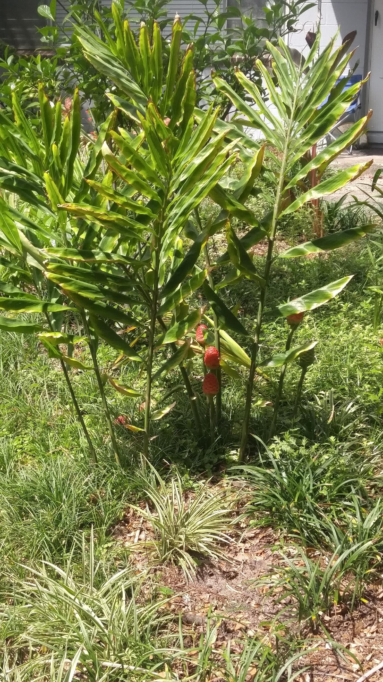

Slide 16
