Slide 1
The Humanistic Effect
“A Prison Abolishment Project”
Prepared and Facilitated by; Culture2Culture

Slide 2
Introductions;
Eddie Perhonitch - eddie@culture2culture.org
Joseph Szeliga - joe@culture2culture.org
Vincent Murray - vinnie@culture2culture.org

Slide 3
Overview
The Humanistic Effect is constructed and will continually develop in and from the combination of lived
experiences from individuals who have been incarcerated as well as individuals who have worked within
the judicial system. Our mission is to eliminate the current models of prison and correctional structures
that are based in punishment, incapacitation, deterrence and rehabilitation with a purpose, driven
by transformation involving; transformative disciplines, restorative placement, rehabilitative incentives
and individualized reintegration strategies.

Slide 4
Objectives
“Present and expand on how the Humanistic Effect works as a platform for system transformation”
Establish the urgency and necessity for abolishing our current prison systems and judicial patterns, especially for individuals with mental illness and substance use disorders.
Define Transformative Justice by comparison to Criminal Justice; facilitated via 20 minute interactive session.
1
3
2
Brief overview of the Sequential Intercept Model and how it provides a framework for segmenting the system for design and structure transformation.
4
Process and discuss theoretical models or concepts in abolishing prison, correctional restructuring and judicial reintroductive policies.

Slide 5
Understanding Prison Abolition

Slide 6
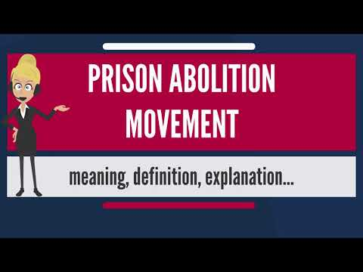
Prison Abolition
01
The prison abolition movement is a formal and informal network of groups and activists that seek to reduce or eliminate prisons and the prison system, and replace them with systems of rehabilitation that do not place a focus on punishment and government institutionalization.

Slide 7
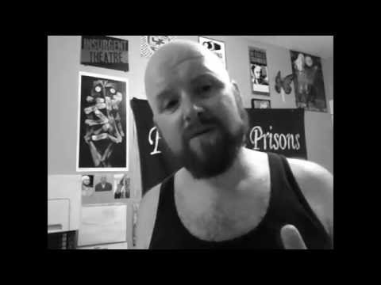
Prison Abolition
02
The prison abolition movement is a loose network of groups and activists that seek to reduce or eliminate prisons and the prison system, and replace them with systems of rehabilitation that do not place a focus on punishment and government institutionalization.

Slide 8
Understanding “The Urgency”

Slide 9
Criminal Justice
01
Criminal justice is the delivery of justice to those who have committed crimes. The criminal justice system is a series of government agencies and institutions whose goals are to identify and catch unlawful individuals to inflict a form of punishment on them. Other goals include the rehabilitation of offenders, preventing other crimes, and moral support for victims.
The primary institutions of the criminal justice system are the police, prosecution, the courts, the prisons and community corrections.

Slide 10
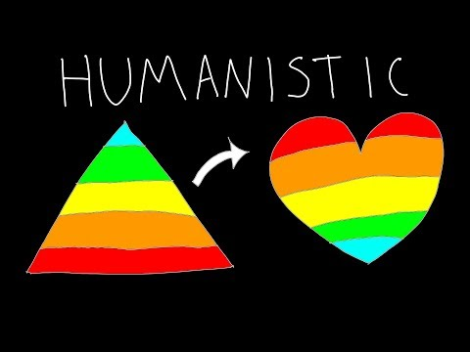
Transformative Justice
02
Humanistic Effect
Transformative justice is the delivery of justice to a human being from one or body of equal human beings. Transformative justice is a collection of government agencies and service institutions whose goals are to identify, interview, inform and sanction individuals with a form of corrective discipline.
Other goals include creating habilitation platforms and rehabilitation incentives for offenders, preventing other crimes with restorative placement, skill development, and mutual support for offenders and victims consisting of individualized reintegration strategies (recitizenship).

Slide 11
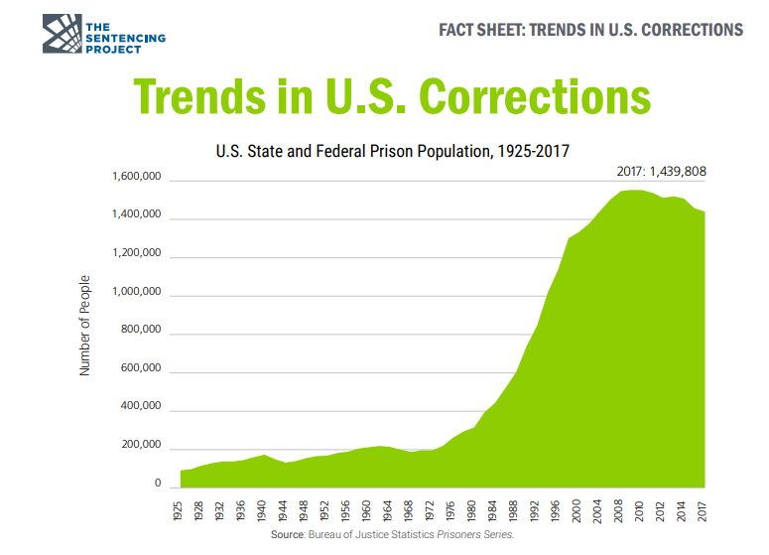
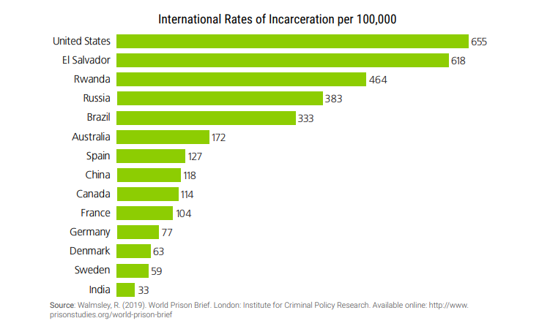
Trend Analysis
The United States is the world's leader in incarceration with 2.2 million people currently in the nation's prisons and jails — a 500% increase over the last forty years. Changes in sentencing law and policy, not changes in crime rates, explain most of this increase. These trends have resulted in prison overcrowding and fiscal burdens on states to accommodate a rapidly expanding penal system, despite increasing evidence that large-scale incarceration is not an effective means of achieving public safety.

Slide 12
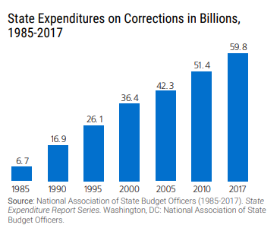
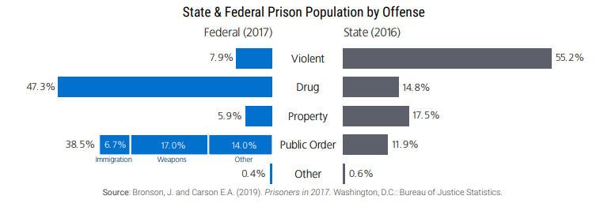

Slide 13
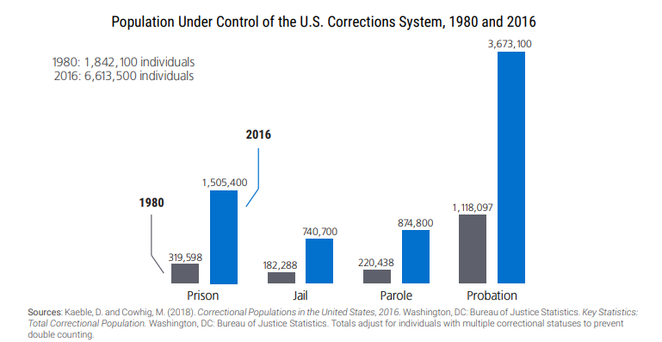
Prison Abolition
Movement Targets
01 | Eliminate 45% of Prison Population
02 | Eliminate 60% of Probation & Parole
03 | Remove 100% of Substance Use Offenders
04 | Remove 100% of Mentally ill Offenders
05 | Activate Suspended Sentencing for all nonviolent crimes

Slide 14
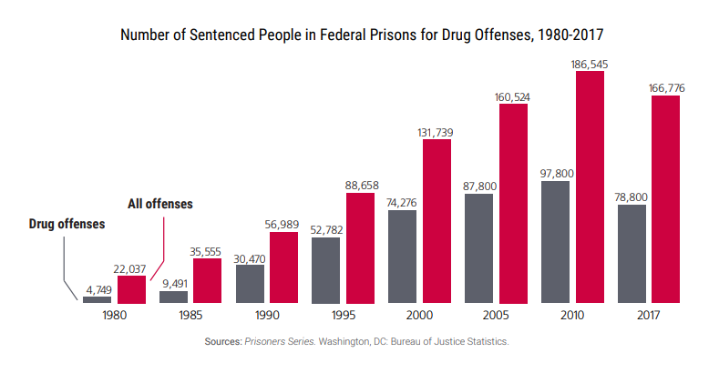
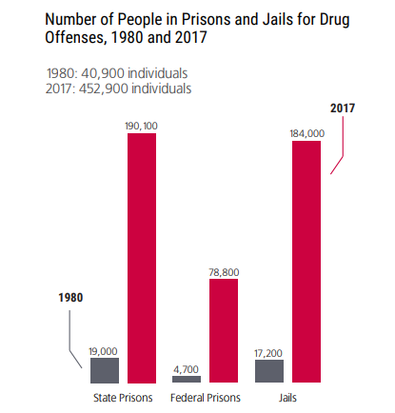
Sentencing policies of the War on Drugs era resulted in dramatic growth in incarceration for drug offenses. Since its official beginning in the 1980s, the number of Americans incarcerated for drug offenses has skyrocketed from 40,900 in 1980 to 452,900 in 2017. By 2004, people convicted on federal drug offenses were expected to serve almost three times that length: 62 months in prison compared to 22 months in 1986.. At the federal level, people incarcerated on a drug conviction make up nearly half the prison population. At the state level, the number of people in prison for drug offenses has increased ninefold since 1980, although it has begun declining in recent years. Most are not high-level actors in the drug trade, and most have no prior criminal record for a violent offense.

Slide 15
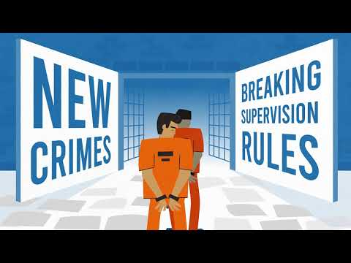
Probation and Parole… The silent assassin to recitizenship

Slide 16
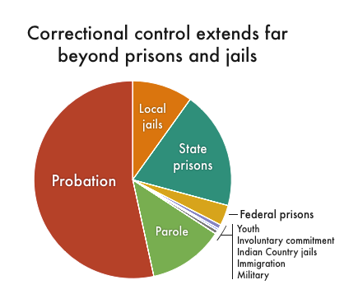
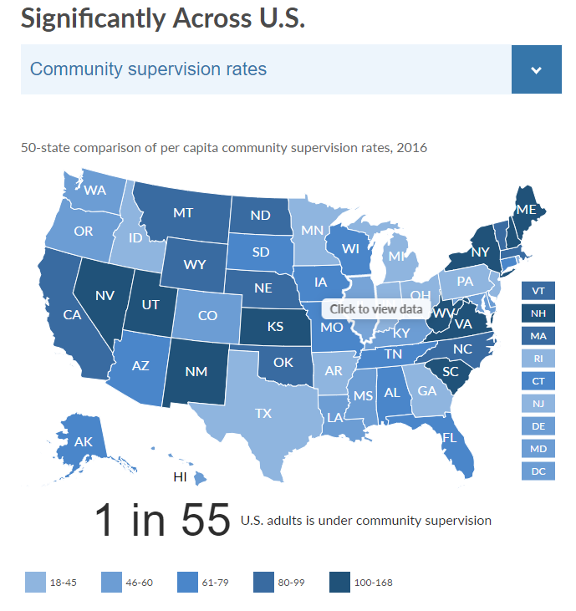
National Mass Incarceration and Supervision
Rates of U.S. Supervision
The vast majority of people under correctional control are on probation and parole, collectively known as community supervision (or community corrections). An estimated 4.5 million adults are under community supervision, nearly twice the number of people who are incarcerated in jails and prisons combined. Yet despite the massive number of people under their control, parole and probation have not received nearly as much attention as incarceration. Only with recent high-profile cases has the public begun to recognize the injustices plaguing probation and parole systems, which set people up to fail with long supervision terms, onerous restrictions, and constant scrutiny. Touted as alternatives to incarceration, these systems often impose conditions that make it difficult for people to succeed, and therefore end up channeling people into prisons and jails.

Slide 17
While far from an exhaustive list, typical probation requirements include:
Paying supervision fees, fines, restitution or other fees ordered by the court, very often without considering the individual’s ability to pay;
Regularly reporting to a parole or probation officer;
Finding and maintaining full-time employment or education;
Submitting to drug and alcohol tests, which the individual is often forced to pay for (this is often a condition even if the offense was not related to drugs or alcohol);
Abiding by strict curfews and submitting to electronic monitoring, which, again, the individual often must pay for;
Not changing employment or residence without permission;
Attending specific programs (such as an anger management class);
Not leaving a designated area without permission (such as the city, county, or state); and
Not associating with people with criminal records, including family and friends.

Slide 18
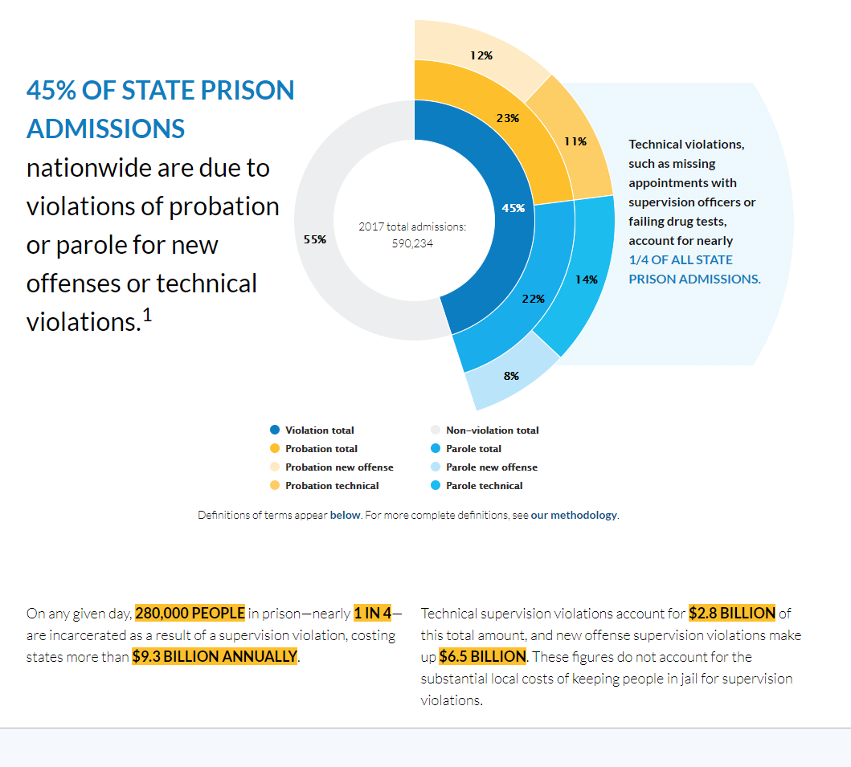
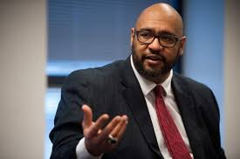
Alarming Probation Problem
Confined and Costly
“Our goal as criminal justice leaders should always be to improve public safety for our citizens by having people leave our custody less likely to commit a crime than when they came to us,” said Pennsylvania Department of Corrections Secretary John Wetzel. “With four times as many people on probation than on parole, policymakers should take a hard look at this population in their states. By doing so, states could achieve larger reductions in crime, arrests and prison admissions and allow criminally involved individuals to be fully restored.”

Slide 19
A Framework... Sequential Intercept Model

Slide 20
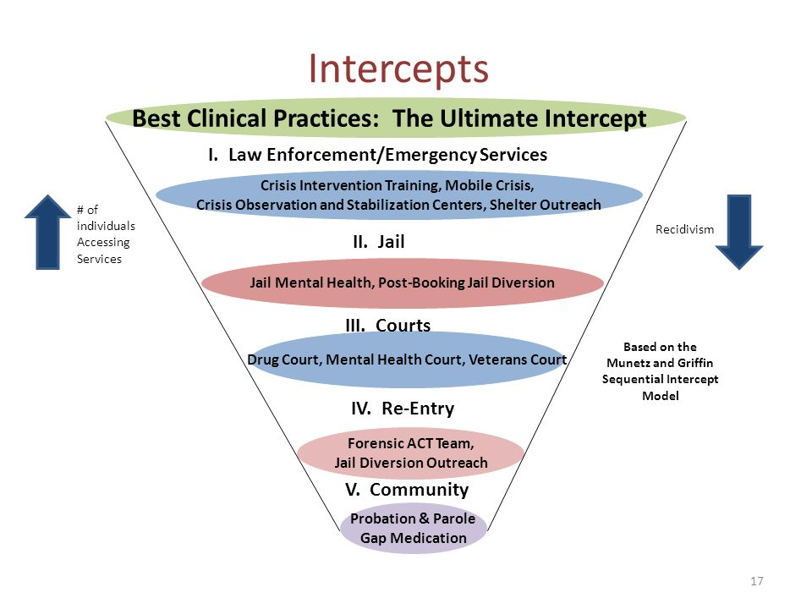
Sequential Intercept Model

Slide 21
What is the Sequential Intercept Model
The Sequential Intercept Model provides a conceptual framework for communities to use when considering the interface between the criminal justice and mental health systems as they address concerns about criminalization of people with mental illness. The model envisions a series of points of intercept at which an intervention can be made to prevent individuals from entering or penetrating deeper into the criminal justice system.
By; Munetz - Griffin

Slide 22
What is the Sequential Intercept Model
The model provides an organizing tool for a discussion of diversion and linkage alternatives and for systematically addressing criminalization. Using the model, a community can develop targeted strategies that evolve over time to increase diversion of people with mental illness from the criminal justice system and to link them with community treatment.
By; Munetz - Griffin

Slide 25
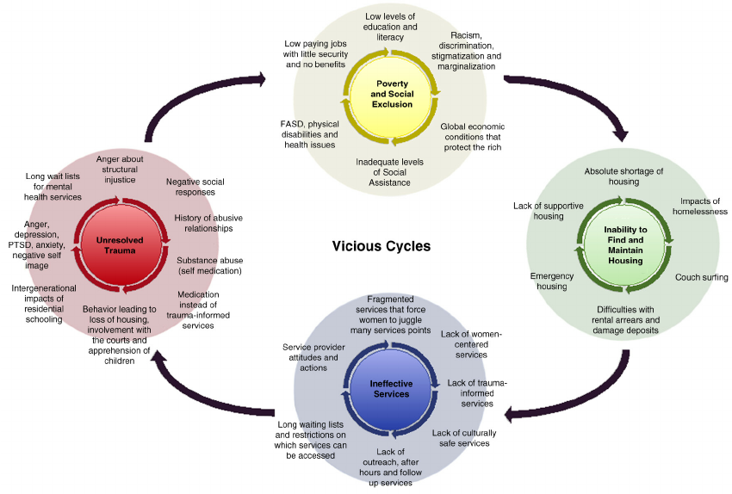

Slide 26
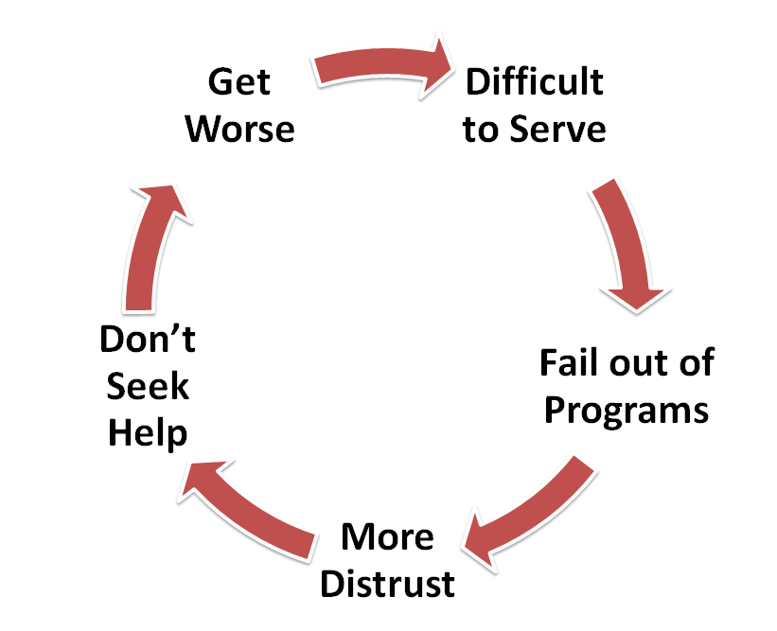

Slide 27
MULTIPLE INTERCEPTS: FRONT END SUBSTITUTION and DIVERSION MOST EFFECTIVE
• Best intervention point is in the community, where treatment needs are met through suspended sentencing and mental health/D&A services, before law enforcement involvement.
• Even with community services in place, some people slip through the cracks and encounter law enforcement.
• In a system with appropriate interventions at each potential intercept, most people should be immediately diverted from justice involvement.
• Individuals with mental illness and substance use disorders who are incarcerated must be connected with services immediately upon arrest, in custody and upon release to prevent further justice system-contact.
• Some people with mental health and substance use challenges need to be incarcerated or justice system involved (violent crimes) and receive a high degree of community supervision and services.

Slide 28
What Is Transformative Justice

Slide 29
The Conundrum, The Call, The Comparison, The Challenge
(The Process)
The Conundrum - is the current disorganized and at select stages dehumanizing state of the prison system
The Call - mobilize and unite in a movement to eliminate or reduce the social impact of incarceration by creating alternatives to the prison system or eliminating it completely
The Comparison - what currently exists and what alternatives meet the call
The Challenge - creating alternatives and influencing the lawmakers to orchestrate laws and policies for the future

Slide 30
The Conundrum, The Call, The Comparison, The Challenge
(The Process)
Current 4 Objectives of the Prison System
Punishment - “It is unquestioned that confinement in a prison . . . is a form of punishment subject to scrutiny under the Eighth Amendment standards.’ ”282 “ Conditions [in prison] must not involve the deliberate and unnecessary inﬂiction of pain, nor may they be grossly disproportionate to the severity of the crime warranting imprisonment. . . . Conditions . . . , alone or in combination, may deprive inmates of the minimal civilized measure of life’s necessities.
Incapacitation - refers to the restriction of an individual's freedoms and liberties that they would normally have in society. Within the criminal justice system, incapacitation is the response used when a person has been imprisoned for a time equal to the crime committed. By incapacitating the convicted offender, the criminal justice system prevents the individual from committing future crimes because he/she is removed from society and locked up or restrained somehow.

Slide 31
The Conundrum, The Call, The Comparison, The Challenge
(The Process)
Current 4 Objectives of the Prison System
Deterrence- is that people don't commit crimes because they are afraid of getting caught - instead of being motivated by some deep moral sense. According to deterrence theory, people are most likely to be dissuaded from committing a crime if the punishment is swift, certain and severe. For example, in the candy bar theft, if there is a low likelihood that you'll get caught or if the punishment for getting caught is just a warning, deterrence theory says you'll be more likely to steal it.
Rehabilitation - is based on the ideas that people are not inherently bad. Instead they are taught to make wrong decisions by environmental influences. This is the classic nature versus nurture argument. Are people born bad or are they made that way due to poverty, bad parenting, economic status, education, trauma, or abuse? Studies have shown how nurturing (environmental influence) affect crime rates.

Slide 32
The Conundrum, The Call, The Comparison, The Challenge
(The Process)
Current 4 Dimensions of the Transformative Justice
Transformative Disciplines - the sanctions; such as suspended sentences, alternative sentencing involving treatment, community services, vocational strategies, housing supports, faith options, educational planning, etc.
Restorative Placement - crime and criminal activity has a way of repeating itself based on lifestyle and habits; restorative placement are innovative options of removing individuals from society based on not meeting sanctions associated with transformative disciplines. Examples of Restorative Placement; Geo-economic Vocational Training Centers, 90-Day Wellness and Recovery Centers, Faith Exploratory Camps

Slide 33
The Conundrum, The Call, The Comparison, The Challenge
(The Process)
Current 4 Dimensions of the Transformative Justice
Rehabilitative Incentives - the concept of incentives within restorative placements to expunging records, family involvement in placement, home passes, job placement,
Individualized Reintegration Strategies (Recitizenship Planning) - criminology is a science developed by observing criminal behavior based on three levels; precrime - crime - postcrime characteristics. Instead of creating mechanisms to “catch” and “punish” individuals associated with criminalistic lifestyles and choices we must observe, invite, challenge and release individuals based on mutually beneficial recitizenship plans of action. IRS (Individualized Reintegration Strategies) must consist of these five dimensions; 1. Individualized & Strength Based 2. Educational 3. Exposure & Influence 4. Awareness(mindfulness) & Regulation (emotional intelligence) 5. Intentional & Empowering

Slide 34
The 9 Perspectives of Prison Abolition
Perspective 1: Imprisonment is morally reprehensible and indefensible and must be abolished.
Perspective 2: The message of abolition requires "honest" language and new definitions.
Perspective 3: We believe reconciliation, not punishment, is a proper response to criminal acts.
Perspective 4: We work with prisoners but always remain "non-members" of the established prison system.
Perspective 5: We are "allies" and “advocates” of prisoners rather than traditional "helpers."
Perspective 6: We realize that the empowerment of prisoners and ex-prisoners is crucial to prison system change.
Perspective 7: We view power as available to each of us for challenging and abolishing the prison system.
Perspective 8: We believe that crime is mainly a consequence of the structure of society.
Perspective 9: We believe that it is only in a caring community that corporate and individual redemption can take place.
www.prsionpolicy.org

Slide 35
Interactive Learning Session
Based on today’s workshop, let’s get started in our interactive learning session! Here are 5 areas to discuss
How can Peer Support help with abolishing prisons?
Why should we abolish prisons?
Where should we start?
Which one of the 4 Dimensions of Transformative Justice makes the most sense?
Do prisons actually make society safer?

Slide 36
Vision… A 10 Year Plan
Formalize a United Front
Institute Pilots Initiative
Implement National Alternative Policies
Gain Support of Lawmakers
National Review of Initiative
Quality and Innovation Planning
2022
2026
2030
2020
2024
2028

Slide 37
“Even if we were to greatly diminish the current prison population, even if we were to cut it in half but keep the prison complex intact, we would still be consigning millions of people to isolation and violence—and that’s a form of inhumanity that abolitionists can’t abide. Moreover, mass imprisonment “reproduces the very conditions that lead people to prison.”
By: Angela Davis

Slide 38
“How have we, a civilized society allowed the prison industrial complex to criminalize what has been long recognized and treated as severe medical conditions such as mental illness and addiction. Both conditions; require treatment and healing not punishment and further exposure to inhumane conditions that are inconsistent with an environment that compliments symptom relief and that are grossly disproportioned to the crime committed…”
By: Eddie Perhonitch

Slide 39
Team
Eddie Perhonitch
Joseph Szeliga
Vincent Murray
Eddie Perhonitch
eddie@culture2culture.org
Joseph Szeliga
joe@culture2culture.org
Vincent Murray
vinnie@culture2culture.org
Co-Founder
and Chief Culturing Officer
Chief Blessings Officer
and Director of Finance and Contracts
Chief Posturing Officer
and Director of Operations
Sales Director
Wendy Writer

Slide 40
Thank you.

